Slide 1
OEM Right to Repair Panel
4/25/2017

Slide 2
Presenters
Brian Herron – Drew Technologies
Bob Stewart – General Motors
Terence Vance – American Honda Motor Co., Inc.
Danny Uhls – Nissan North America
Tu Tran – Porsche Cars North America
David Stovall – Toyota Motor North America
Kurt Immekus – Volkswagen Group of America
Craig Jeffries – Subaru of America

Slide 3
Background
Massachusetts Right to Repair Referendum put on ballot
Model year 2015+ vehicles
Included Heavy Truck, motorcycles
… And telematics
National MOU was signed as a compromise before the ballot was put to a vote
Changed to model year 2018+
Heavy Truck and motorcycles omitted
Telematics also removed
After MOU signed, Massachusetts ballot referendum still passed
Massachusetts congresss ratified the right to repair law to match the MOU
As of today MOU is voluntary in 50 states, but Massachusetts R2R compliance is a requirement for any car maker that wants to sell cars in Massachusetts

Slide 4
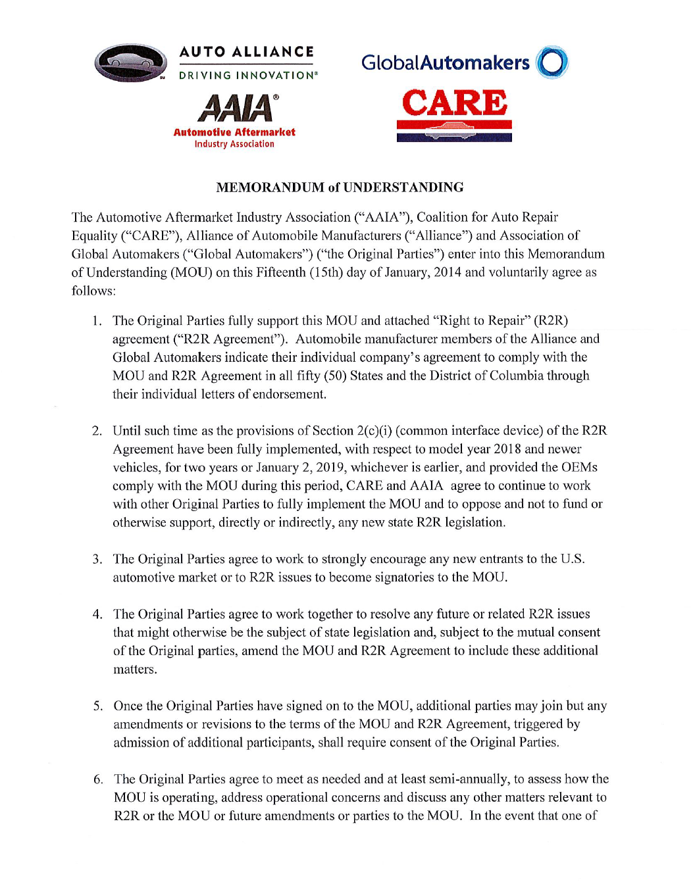
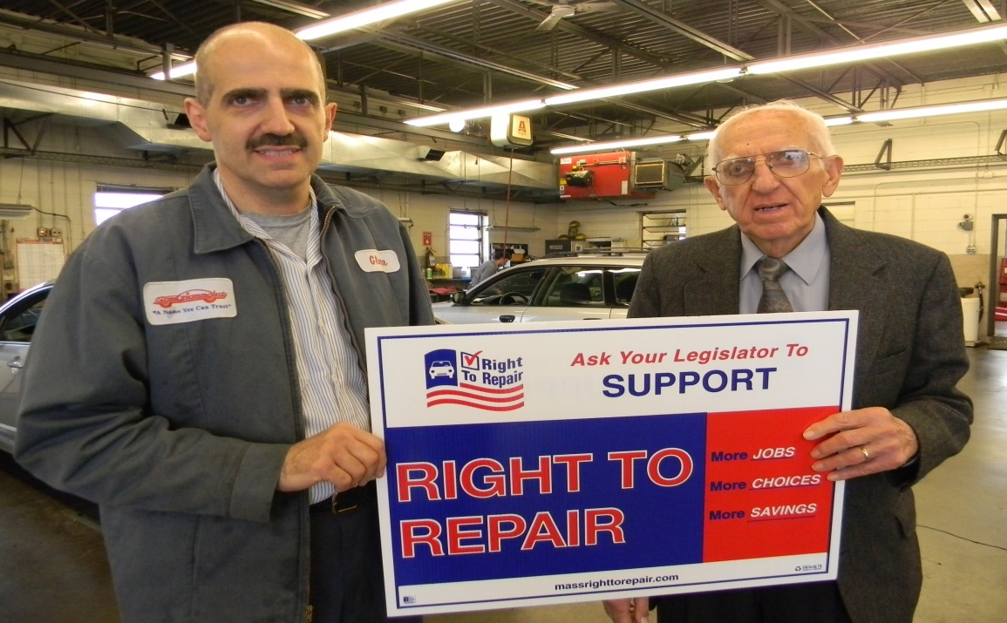
MOU

Slide 5
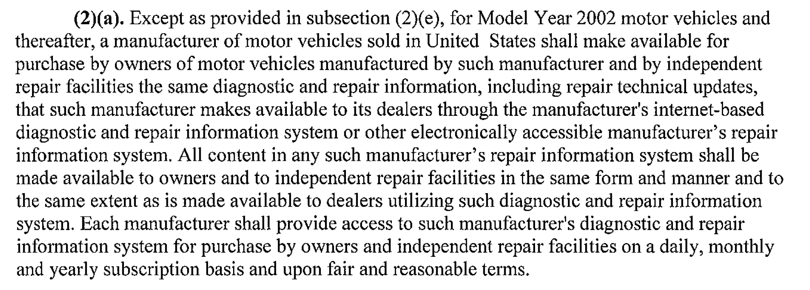
Important Sections in R2R MOU

Slide 6
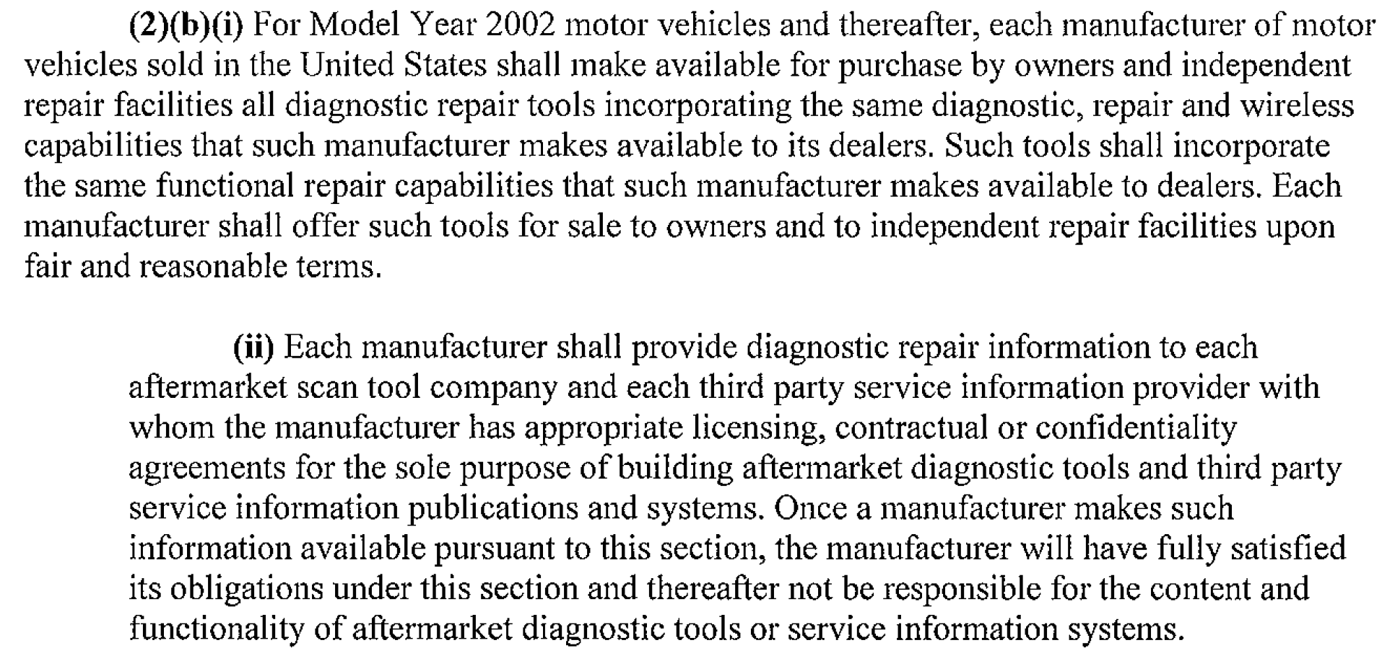
Important Sections in R2R MOU

Slide 7
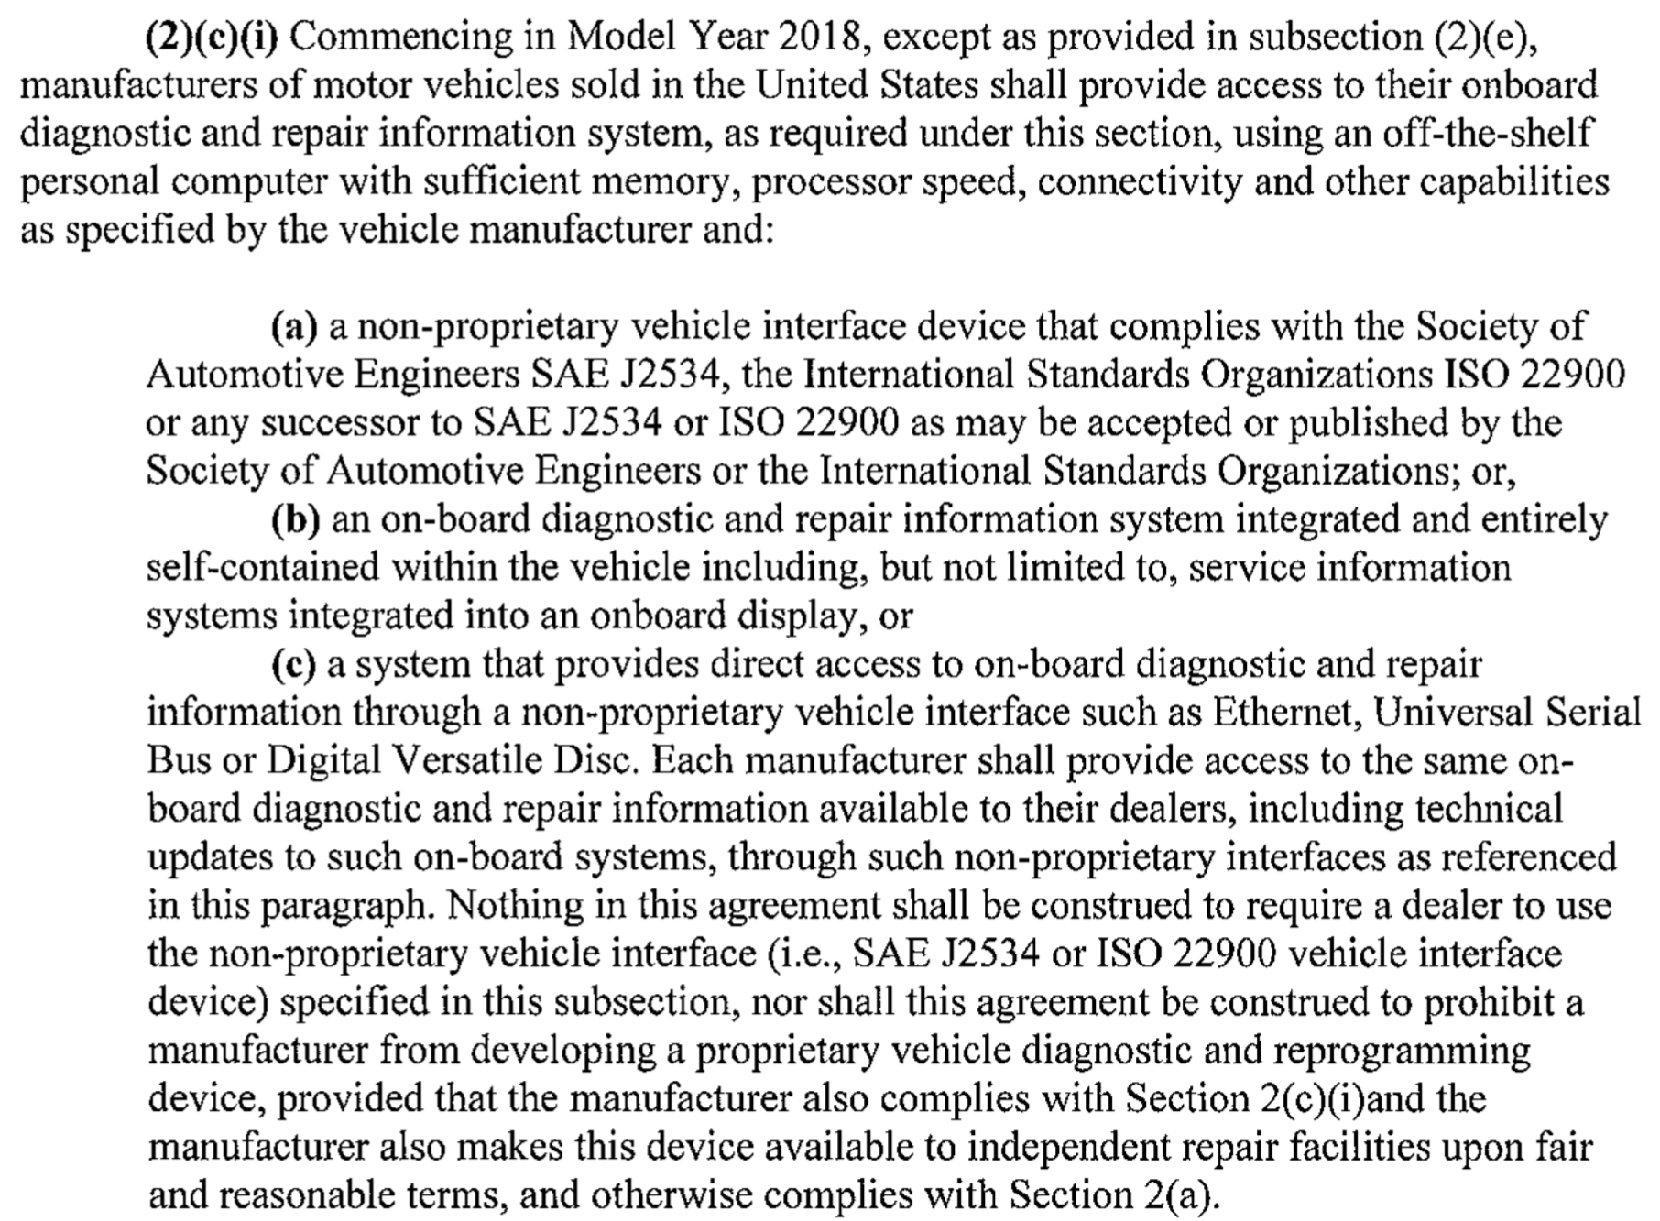
Important Sections in R2R MOU

Slide 8
Important Sections in R2R MOU

Slide 9
Development Effort
Right to Repair requires that OEM diagnostic systems be made available to anyone
For a reasonable price
At the same “content level” as the dealership has
Using a “Pass-Thru” interface such as J2534, RP1210, or ISO22900
100% coverage, except for “recall” tools
Some OEMs immediately were complaint with existing systems.
Other OEMs had to undergo substantial development to release OE diagnostics using a standardized interface
Another substantial effort was subscription delivery.

Slide 10
OE Reports

Slide 11
General Motors Bob Stewart

Slide 12
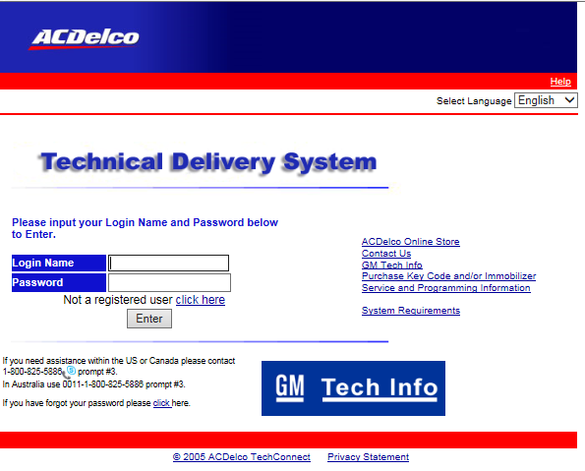
www.acdelcotds.com

Slide 13
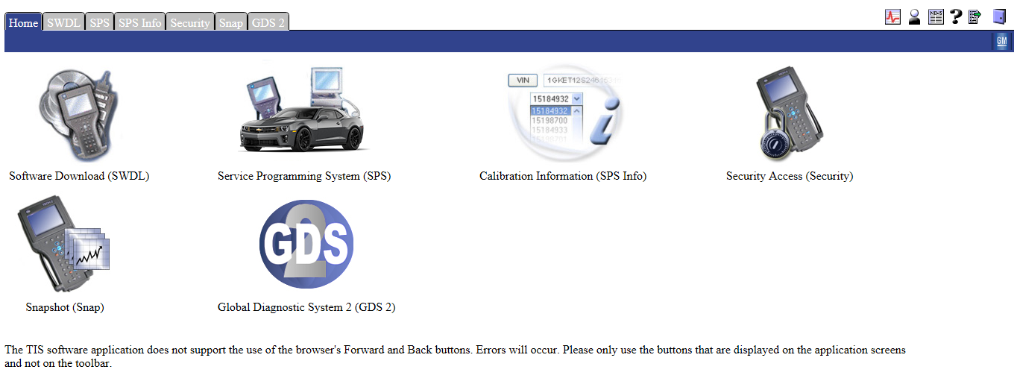
General Motors Programming And Diagnostic Scan Software
Service Programming (SPS)
Global Diagnostics System 2 (GDS2)
Tech 2 Win

Slide 14
Global Diagnostics System 2
Available subscriptions
3 day
1 month
1 year
License renewal ever 30 days
List all tool dll
J2534-2 04.04

Slide 15
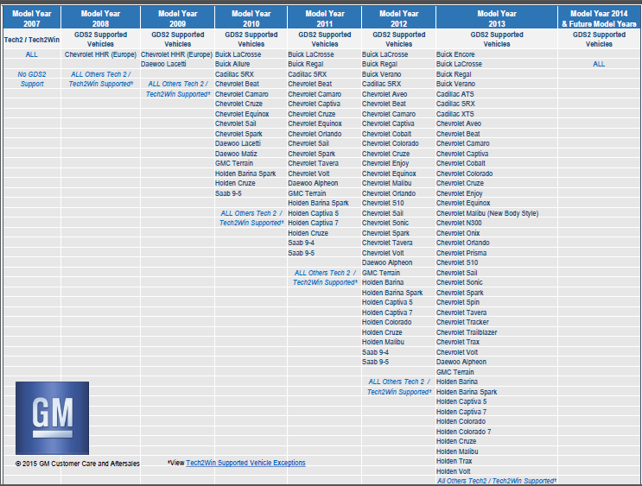
www.gmgds2.com

Slide 16
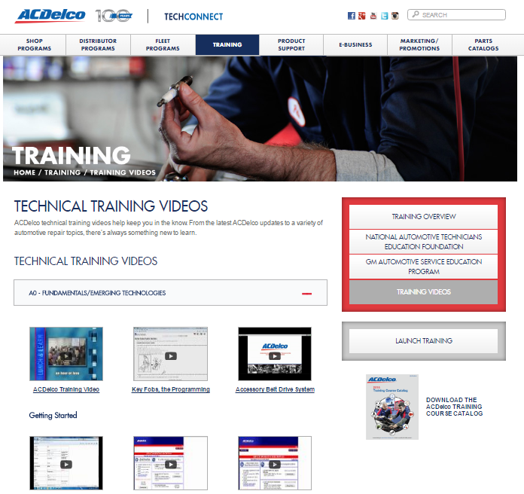
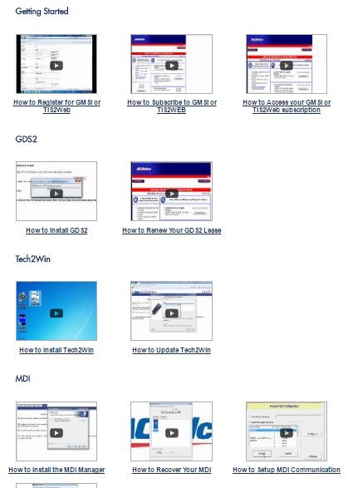
Training
www.acdelcotechconnect.com
Training tab
Training videos

Slide 17
Resources
www.acdelcotds.com
http://www.gmdesolutions.com/services/
www.gmgds2.com
www.acdelcotechconnect.com
http://scantoolresource.com/

Slide 18
Coverage
MOU Section | Requirement | Is OE Compliant to MOU | Year Range offered by OE | Where to find this information
2(a) | Diagnostic Information for 2002-newer vehicles | Yes | 1992-up | www.acdelcotds.com
2(b)i | Diagnostic tools for 2002-newer vehicles | Yes | 1996-up | http://www.gmdesolutions.com/services
2(b)ii | Make Scantool data available thru a license | Yes | 1996-up | Dante
2(c) | Pass-Thru support for 2018+ vehicles | Yes | Tech2win – 1996-2014 GDS2 – 2010-up 2010-2014 vehicles may need GDS2 or Tech2WIN | www.acdelcotds.com
2(d) | Immobilizer programming | Yes | 1996-up | www.acdelcotds.com

Slide 19
American Honda Motor Co. Terence Vance

Slide 20
2018 R2R MOU Compliance
MOU Section | Requirement | Compliant ? | Year Range Offered | Where to find this information
2(a) | Diagnostic Information for 2002-newer vehicles | Yes | 1990~ | https://techinfo.honda.com
2(b)i | Diagnostic tools for 2002-newer vehicles | Yes | 1996~ (1992-1995 with adaptor) | https://techinfo.honda.com
2(b)ii | Make Scantool data available thru a license | Yes | 1992~ | etools.org/OEMLicensing
2(c) | Pass-Thru support for 2018+ vehicles | Yes | 2001~ (reprogramming) 1992~ (diagnostics) | https://techinfo.honda.com
2(d) | Immobilizer programming | Yes | 1998~ | https://techinfo.honda.com

Slide 21
Pass Thru Application – i-HDS
i-HDS (Honda Diagnostic System) diagnostic software suite – AVAILABLE NOW
URL – https://techinfo.honda.com
Dealers and aftermarket use the same application for both reprogramming and diagnostics
Convenient subscription options
1 day: $10
30 days: $133
365 days: $1,547
BYOD J2534-compliant (API v04.04)
Denso DST-i and Bosch MVCI – Honda validated

Slide 22
Pass Thru Exemptions
Acura Link (early 2000s Acura models)
Traffic, weather, maps update
Requires GNA600 tool kit (available through AHM tool and equipment program)
Hands Free Link Control Unit Update
Bluetooth pairing of mobile phone to head unit
Requires BT adaptor (v2.1 or higher)
EPS Rewrite Recall (specific 2013/2014 Accord models)
Electronic Power Steering software update
To be completed by dealer to complete the open campaign
Requires “MongoosePro Honda” VCI with specific firmware
Notes:
GNA600 – Teradyne
HFL – Johnson Controls
EPS Rewrite – Drew Technologies

Slide 23
Training Resources
Information is available on https://techinfo.honda.com
American Honda provides collision repair training, hosted by i-CAR
For more information, please visit:
https://www.i-car.com/Home/OEM

Slide 24
Other Topics
Is Honda including the same VIN specific build data that they are providing their franchised dealers?
Yes. Detailed VIN information is provided in the same service manual information that we provide to dealers.
How is Honda letting independents know about how pass thru software is being released?
Service Express (https://techinfo.honda.com) is our primary means for communicating software released to independent repair facilities.
If you’re a current i-HDS subscriber, HDM will alert you of new versions of software.

Slide 25
Nissan North America Danny Uhls

Slide 26
Diagnostic and Repair Information
Service Manuals, Technical Service Bulletins, Tech Talk magazines and training modules from early 1990s to current
Available at: Nissan or Infiniti TechInfo Website
(www.nissan-techinfo.com & www.infiniti-techinfo.com)
Online Viewing Subscription Cost:
One Year Subscription - $720.00
90 day Subscription $225.00
30 day Subscription $75.00
One day Subscription $19.99

Slide 27
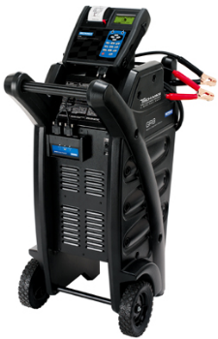
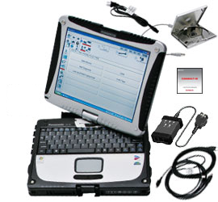
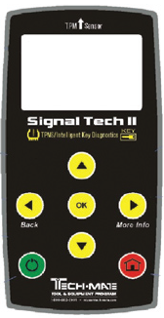
Diagnostic Tools Availability
Nissan or Infiniti TechMate Website
(www.nissantechmate.com & www.infinititechmate.com)

Slide 28
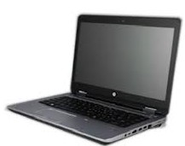
Diagnostic Software for Off-the-Shelf PC
(CONSULT III Plus R2R)
CONSULT III Plus R2R diagnostic software installs on any personal computer that meets the software operating specifications
Released: April 25, 2017
Software and additional information available at: Nissan or Infiniti TechInfo Website (www.nissan-techinfo.com & www.infiniti-techinfo.com)
Software currently supports all Nissan and Infiniti 2018 model year vehicles. Supports full diagnostics, same as dealer version.
Vehicle Interface Required: Drew Tech CarDAQ-Plus 2
Cost: $ 500 (software), includes one year of updates
$ 25 (training video)

Slide 29
Diagnostic Software for Off-the-Shelf PC
(CONSULT III Plus R2R)
Software does not support ECU programming
NERS software will continue to support ECU programming
Software does not support immobilizer programming
See next slide for additional information
CONSULT III Plus R2R Full Version Release : December 2017
Same as dealer version (1990s to current MY vehicle application, reprogramming/programming/immobilizer)

Slide 30
Immobilizer Programming
Current CONSULT III Plus R2R diagnostic software does not support immobilizer programming.
Immobilizer programming can be performed:
By a registered security professional with valid NASTF registry
With a Nissan Panasonic CF-19 Toughbook PC, vehicle interface and security card purchased from Nissan or Infiniti TechMate along with CIII Plus software
With immobilizer pin or key code purchased from Nissan or Infiniti TechInfo website

Slide 31
Porsche Cars North America Tu Tran

Slide 32
Pass-Thru
https://techinfo2.porsche.com/PassThru/user/ShowInfo.action?url=../user/passthrudevices.html&menulevel=2

Slide 33
Dignostic Devices
For reprogramming and flashing Porsche vehicles without a factory diagnostic device, Porsche recommends the following devices: Recommended Pass Thru Devices: • I+ME ACTIA Passthru+ XS 2G • Snap-on Pass Thru Pro II Porsche is not responsible for any content on these two external sites
Factory Diagnostic Tools: Porsche factory diagnostic tools are available from Porsche Cars North America, Inc.

Slide 34
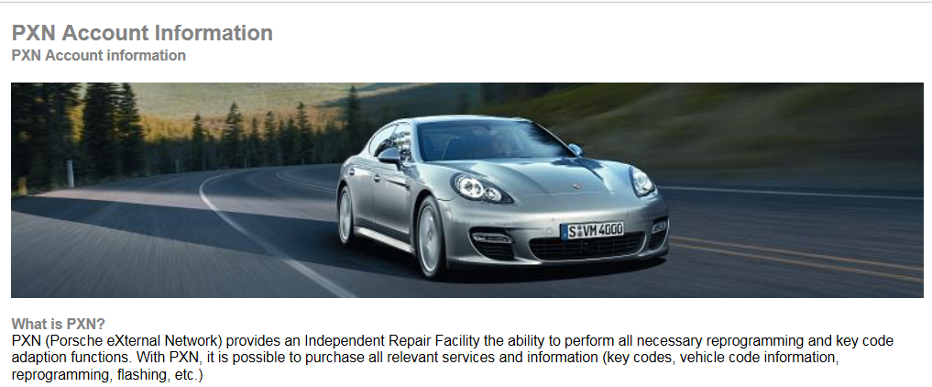
PassThru Application
Website for software -https://techinfo2.porsche.com/PassThru/user/pxnaccount.html
PXN is different for the Aftermarket
PXN is offered long term and self defined pricing.
Projected release date for this system if not available now – available NOW
Pass-thru Interface: J2534 (04.04, V5), ISO22900, RP1210, or multiple
Devices validated, or self-validated

Slide 35
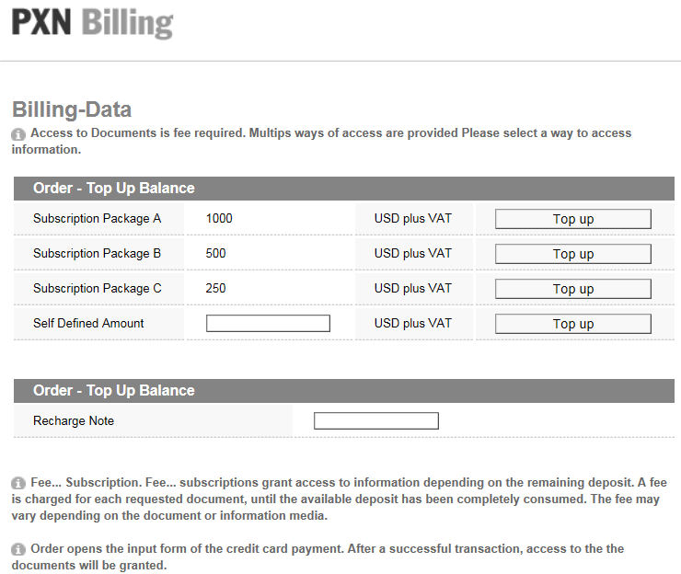
Training Information
Where to get it - https://techinfo2.porsche.com/PassThru/user/ShowInfo.action?url=../user/pxnaccount.html&menulevel=0
How much does it cost –

Slide 36
Toyota Motor North America David Stovall

Slide 37
OE Status on Compliance
MOU Section | Requirement | Is OE Compliant to MOU | Year Range offered by OE | Where to find this information
2(a) | Diagnostic Information for 2002-newer vehicles | Yes | 1990 and Later | www.techinfo.toytoa.com
2(b)i | Diagnostic tools for 2002-newer vehicles | Yes | 2001 and later | www.techinfo.toytoa.com
2(b)ii | Make Scantool data available thru a license | Yes | 2001 and later | www.techinfo.toyota.com
2(c) | Pass-Thru support for 2018+ vehicles | Yes | 2001 and later | www.techinfo.toyota.com
2(d) | Immobilizer programming | Yes | 2001 and later | www.techinfo.toyota.com
Notes:
37

Slide 38
Pass Thru Application
Current validated pass thru applications:
MongoosePro MFC2 (exclusive dealer VIM)
Bosch Diagnostics Flasher LT-Import and PRO
DG Technologies VSI-2534
Snap-On Pass Thru Pro II
*NOTE: Please check website for applicable firmware, DLL and OS combinations
Notes:
38

Slide 39
Pass Thru Application
Pricing:
All devices validated against J2534 04.04 standard
Software available at www.techinfo.toyota.com
Notes:
39

Slide 40
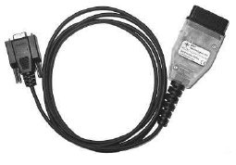
Pass Thru Exemptions
Recall A0G – 2003 Sequoia VSC ECU Reprogramming
Specialized cable and software required
DLC3 → RS232 connector
Cable available for purchase
Software available with Techinfo subscription
Notes:
40

Slide 41
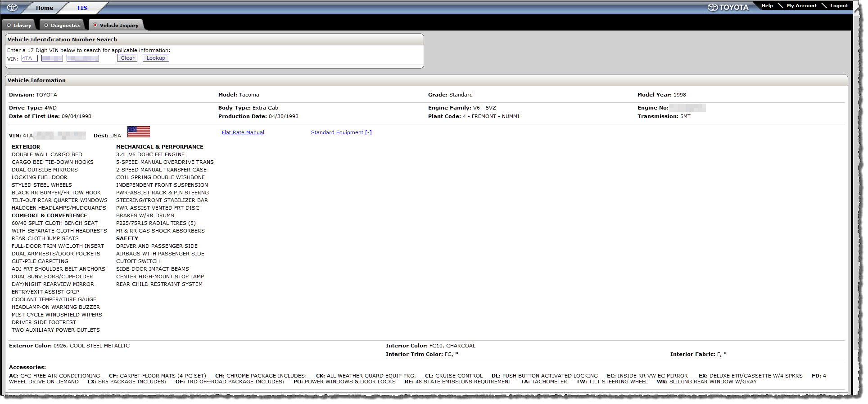
VIN Specific Build Data
Available at www.techinfo.toyota.com
Notes:
41

Slide 42
Training Information
Available at www.techinfo.toyota.com with all levels of subscription
Also available for licensing. For licensing information please contact:
Mark King
Bosch Automotive Service Solutions
mark.king@us.bosch.com
586-582-5828
Janice Mondary Bosch Engineering North America
janice.mondary@us.bosch.com 586-578-7448
Notes:
42

Slide 43
Volkswagen Group of America Kurt Immekus

Slide 44
MOU Section | Requirement | Is OE Compliant to MOU | Year Range offered by OE | Where to find this information
2(a) | Diagnostic Information for 2002-newer vehicles | Yes | 1999 - 2018 | Erwin Website and ODIS software
2(b)i | Diagnostic tools for 2002-newer vehicles | Yes | 1999- 2018 | Erwin, Snap-on Business solutions All of the VAS tools
2(b)ii | Make Scantool data available thru a license | Yes | Current ODX data year to year
2(c) | Pass-Thru support for 2018+ vehicles | Yes | 1999-2018 | ODIS software set-up
2(d) | Immobilizer programming | Yes | 2002-2018 | ODIS Software and a security ID
Kurt Immekus Volkswagen Group

Slide 45
J2534 with ODIS
System Name: ODIS (Offboard Diagnostic Information System)
Availability Erwin website (Registration and software download)
Same system the dealers use with no limitations
Subscription length One Year only $750.00 per brand
Volkswagen, Audi, Bentley and Lamborghini available
Release date January 2012
Pass Thru J2534 Version 04.04
Validation As requested by mfg.

Slide 46
J2534 with ODIS
ODIS features not supported by pass-thru:
Not aware of any.
There are couple of special tools that work in conjunction with ODIS
VAS 6558A Hybrid Tester
This is special high voltage test box that connects to the VAS 6150D platform through a “ruggedized” round USB connector . Adapters available commercially.
VAS 6356 Measurement Tool
Occasionally for special test the ODIS “Guided Functions” users will be asked to enter measurements using the VAS 6356

Slide 47
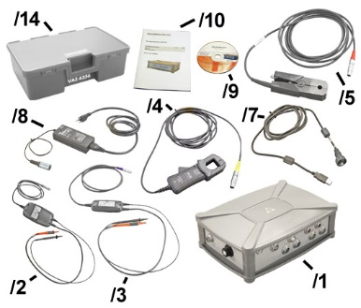
ETI Tool Tech
VAS 6558A
VAS 6356

Slide 48
Training Information
Where do you get training information?
Erwin: Self Study programs and Videos are available under the “training “ heading in the Guided Search menu
https://erwin.vw.com https://erwin.audiusa.com
Audi and VW core training programs available for professional trainers on our literature fulfillment sites under the “Training” tab
literature.vw.com literature.audiusa.com
We are planning to add more Self Study bundles in this area
The ODIS operators training manual is available within the ODIS software bundle

Slide 49
VIN specific build data
VIN Specific data is available on Erwin under the VIN search tab
The same search function the dealers use
When you log on to ODIS the VIN is recognized and all of the available guided functions and test plans that apply to that VIN are available.
For VW brands there is a system known as “Service 42” where all of the software updates are stored. Specific updates are references by an SVM (software version management) number on the technical bulletins

Slide 50
J2534 with ODIS during software install

Slide 51
J2534 with ODIS during install

Slide 52
J2534 with ODIS during install

Slide 53
J2534 with ODIS
After Software Installation

Slide 54
J2534 with ODIS

Slide 55
J2534 with ODIS

Slide 56
J2534 with ODIS

Slide 57
J2534 with ODIS

Slide 58
J2534 with ODIS

Slide 59
Subaru Craig Jeffries

Slide 60
https://stis.subaru.com

Slide 61
Coverage
MOU Section | Requirement | Is OE Compliant to MOU | Year Range offered by OE | Where to find this information
2(a) | Diagnostic Information for 2002-newer vehicles | Yes | 1995-up | https://stis.subaru.com Subaru Technical Information System
2(b)i | Diagnostic tools for 2002-newer vehicles | Yes | 2002-up | https://stis.subaru.com Subaru Select Monitor 4
2(b)ii | Make Scantool data available thru a license | Yes | 2002-up | http://etools.org/OEMLicensing
2(c) | Pass-Thru support for 2018+ vehicles | Yes | 2018-up (some earlier MY support) | https://stis.subaru.com Subaru Select Monitor 4
2(d) | Immobilizer programming | Yes | 2002-up | https://stis.subaru.com Subaru Select Monitor 4

Slide 62
Pass Thru Application – Subaru Select Monitor 4 (SSM4)
Available through: Nuspire Networks 3155 Dallavo Court Commerce, MI 48390 Tel: (877) 782-7404
Retailers and aftermarket use the same application for Immobilizer support, reprogramming and diagnostics.
J2534-compliant (4.04 standard)
Denso DST-I, DrewTech CarDAQ M and CarDAQ PLUS – Subaru validated

Slide 63
Panel Discussion and Audience Questions

