Slide 1
Industry Trends and Emerging Technologies
April 26, 2017
Notes:
Hi, my name is Ben Johnson and I have the best gig at this event – getting to talk about our industry, trends within our industry and the emerging technologies we’ll be seeing.

Slide 2
Agenda
1. About Me
2. Consumer Trends
3. Emerging Technologies/Trends
Notes:
I expect to cover 3 broad topics – well, 2 broad topics and one really fast one!
Transition - I’ll talk (only briefly, I promise) about me,
Transition - then we’ll review some of the trends we see relative to the consumer and how that’s impacting us.
Transition – then the fun stuff – focusing on the trends of technology, what we are seeing now and when we can expect to see other technologies and how those might impact us in the automotive repair industry.

Slide 3
Industry Affiliations
Involved with Auto Care Association since 1998
Involved with ETI since 2002
Currently on Telematics Task Force
Currently on Emerging Technologies Committee at Auto Care Association
Notes:
I’ve been pretty involved with the industry
Transition – I’ve been either a member of, or employed by, the Auto Care Association (back then it was AAIA) since 1998. I served on the electronic standards committee for several years, and am past chairman of that committee.
Transition – I’ve been involved with ETI since 2002, and am a past-president of that association.
Transition – I currently serve on the Telematics task force which is a collaboration of all the trade associations.
Transition – and I’m on the Emerging Technologies task force with Auto Care Association which is pretty much focused on the connected car initiatives currently.
So that’s me – when I’m not working I enjoy life in San Diego where we do a lot of boating, dirt biking and whatever activities my 3 kids have me involved with at any given time – which means I have a lot less time for boating or dirt biking than I used to!

Slide 4
Consumer Behavior
Notes:
OK, lets transition to consumer behavior. Some of this might be review, but its always interesting to understand what drives the people who are driving their cars to or past our shops.

Slide 5
Change in U.S. Driving Volume
2012 Up 0.3%
2013 Up 0.6%
2014 Up 1.7%
2015 Up 3.5%
2016 Up 2.8%
Source: IHS Automotive, DOT and FHWA
Notes:
In fact, a LOT more!
This shows year over year growth over past 25 years…green bars above the line are good, red bars show declines in VMT…
As you can see….5 straight years of growth:
Transition - 2012 – just under ½ percent
Transition - 2013 – just over ½ percent
Transition - 2014 – up nearly 2% -
Transition - biggest increase in 10 years - since 2004 – 10 years!
Transition - 2015 – up 3.5% - haven’t seen that size yr over yr growth since 1992 – best in nearly 25 years!
Transition - 2016 still grew at about 2.8%, slowing just a bit but still a solid growth year!
Now jury is still out as to whether this trend will continue…but for now, we’re seeing a very positive trend in VMT again and that’s a great thing for the aftermarket!

Slide 6
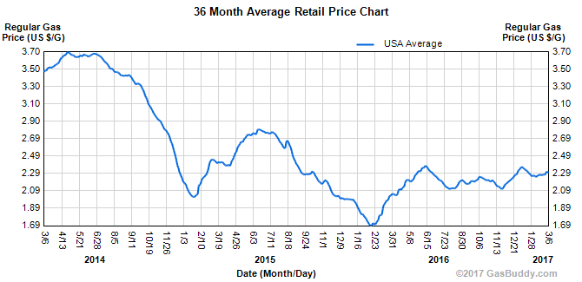
VMT Success Linked to Gas Prices
-18% vs
2 Year Peak
-38% vs
3 Year Peak
Notes:
Obviously helped by gasoline prices being down…Lowest sustained prices since 2009.
It becomes obvious the tie in between miles driven and gas prices/cost to run our vehicles.
Nat’l Avg from last week was about $2.29… roughly flat to a year ago…..but you can see the volatility over time.
But overall gas prices are down…
Transition - in fact down about 18% over the past 2 years….
Transition - and nearly 40% just since 2014.
Clear correlation between lower gas prices and higher sustained vehicles miles travelled…so jury is out as to how long this trend will continue, but for now it is a major positive trend for the aftermarket business!

Slide 7
U.S. Light Vehicle Sales
2016 = 17.6 million units
5.8%
Flat
History
Forecast
Forecast Peak Again = 17.6MM in 2018
Source: IHS Automotive
Notes:
7
This shows our US new light vehicle sales history and forecast…
Grey bars are history….red is the most current actual = 2016 – and green is our forecast. You can see that 2015 was the first year since 2000 we surpassed 17 million vehicles sold, with a pretty good outlook through the forecast period.
Meanwhile, you can see we’re coming off of 6 straight years of positive year over year growth….this is the longest string of YR/YR increases in about 100 years! Last time it happened was in the 1920’s.
This is a great thing for the repair industry – simply more vehicles to repair down the line….
What’s interesting to look at is the decline we saw (transition) beginning in 2008. Of course we felt it then, and that’s driven our average age increase we keep talking about. We’ll talk about that again in a few minutes.

Slide 8
Change in Mix – Domestics vs Imports
+8
9%
17%
23%
27%
+4
39%
% of Total U.S. Vehicles-in-Operation
37%
-2
29%
19%
-10
Source: IHS Automotive
Notes:
We continue to see import badges taking market share from the “legacy” “Detroit 3”. Its hard for me to label them as Domestic vs Import anymore, since many of the badges are import but production and component manufacture of many of them have shifted to the U.S. and many components and assembly for legacy Detroit automakers has shifted to outside-US factories.
Domestic cars has lost about 10 points in market share over 10 years.
Dom Lt Trucks – which include crossovers and SUV’s - stay about the same at 2 share point loss – to be expected, Big 3 still remain leader in lt trucks.
Import Cars – picked up 4 share points.
But Import Lt Trucks – gained 8 share point gain when looking over this time span. This tells us that while the Domestic 3 lost a little share in light trucks, most of the domestic car share loss was to import trucks, which is going to be interesting to watch. Again, that category includes the SUV/Crossover segments, which likely make up a large part of that share gain.

Slide 9
U.S. Light Vehicles in Operation
History
Forecast
Data as of January1 each year.
Source: IHS Automotive
Notes:
Now let’s look at U.S. VIO – total vehicles in operation
The US new vehicle growth I talked about is having positive impact on our VIO here at home….Today we stand at about 264 million light vehicles.
We see nice steady growth over next 5-6 years – up over 10% and hitting breaking 291 million units by 2021…
Why growing:
- New light vehicle sales continue to hit record levels
- People holding their cars longer
- Cars lasting longer
Simply more cars and light trucks on the road for the aftermarket to service. What’s continuing to occur is a gradual shift in the average age of the vehicles in operation, though.
9

Slide 10
Average Age – Slowing Down
2019
2017
11.8
2016
11.7
2014
2015
11.6
11.5
11.4
Source: IHS Automotive
Notes:
So we don’t see it dropping, just slowing down to it’s normal rate of growth.
Last year = 11.6
Increased to 11.7 this year
And won’t get to 11.8 until 2019
But what is most interesting, however, is how all of this is impacting age groups within the VIO and how it might be changing the aftermarket as we know it…

Slide 11
Average Age Impact on VIO Units
Units
Source: IHS Automotive
Notes:
Looking at the VIO from 2002 out to 2021
Broken out into the 3 groups I just talked about … new-5 years = red 6-11 years = blue and 12+ = green
Back in 2002 – the oldest vehicles were the smallest group…you an see the 6-11 year group begin to really rise – this reflects the boom years of new sales from back in late 90’s and early 2000’s
But the chaos began with the recession…the lines get a bit crazy…new-5 year drops off significantly with the 40% drop in new vehicle sales.
Right now, we’re in a decline for the 6-11 year old vehicles…but like I said, you can see it rising between now and 2021
What’s causing this volatility is the lack of 2008, 2009, 2010 etc. model year vehicles…this has to work its way through the system.
But as you can see – the oldest vehicles – the green line – is growing the fastest! So that’s good, but bad, right? If the volume of 12+ year old vehicles increases, they’re going to start needing work. But how much will consumers spend to keep them in good condition? So it will drive the need for “good, better, best” parts strategies, and by 2020, think about it – your 12 year old vehicle is a 2009 which was the beginning of some pretty interesting technologies. It will be interesting to watch.
In the meantime with our current sales ramp-up, beginning in 2020 the 6-11 year old vehicles on the road begin to grow drastically, which will help feed the pipeline of “newer but out of warranty” repairs available. And they’ll be the next wave of “higher technology” vehicles with aging enhanced electronics on board.

Slide 12
Emerging Technologies/Trends
Connection
CAFÉ & Global Emissions Standards
Safety
Notes:
What’s actually driving the emerging technologies we’re seeing today? Three things:
Transition – 1. CAFÉ and Global Emissions Standards
Transition – 2. Safety
Transition – 3. Connected Vehicles

Slide 13
Global CO2 & Fuel Efficiency Regulations
86 MPG
CAFÉ & Global Standards are Merging
54.5 MPG
2030
2025
To reach this goal, every OEM must improve fuel efficiency by 5% per year!
2016
35 MPG
Notes:
As we all know, in 2009 the government set a fuel economy standard of around 35 MPG for cars and light trucks by 2016.
In 2012 the government set a target of 54.5 MPG by 2025 target…
By 2030, while the U.S. hasn’t required it yet, global CO2 and fuel efficiency regulations all begin to merge at 86 MPG!
To reach these targets, every OEM must increase fuel efficiency by 5% per year! Many OE’s are stating the only way to achieve those numbers is by eliminating the ICE engine; some countries predict there will be no ICE engines sold in their markets (going full electric technology) by 2030.

Slide 14
Compliance Gaps Emerging
OEMs are developing strategies for widening compliance gaps:
New technologies, light-weighting & electrification will all play critical roles.
CAFE Target
Gap
CAFE Target
Gap
Compliance gaps are increasing in NA, Europe and China
Source: IHS Automotive
Notes:
In the US, customers have not embraced the hybrid/EV vehicles, and beginning about 2020, current projections are that the VM’s are missing the requirements.

Slide 15
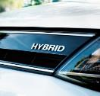
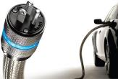
Share of Global Sales
2016
2020
2025
Mild Hybrid
Full Hybrid
Plug-In Hybrid
BEV
3% 9% 18%
0.0%
Notes:
In fact, Hybrid vehicles in all their incarnations still made up less than 3% of all car sales in 2016. The projection is that will triple by 2020, but in much of the US consumers still aren’t willing to pay for them.
Mild = batteries don’t run the powertrain…store power from braking system and send it to powertrain when needed
Full = batteries can run powertrain right next to ICE
Electric vehicles less than 1% and fuel cells will be negligible

Slide 16
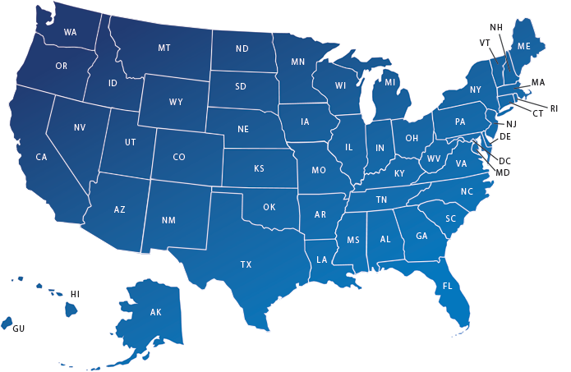
2015 Top 10 Markets for Hybrid Registrations
More than 30% of all hybrid registrations are in these ten DMAs
Source: IHS Automotive
Notes:
In fact, the biggest areas, and frankly the only reason the percentage is even what it is, is the tree-hugger states which embrace these “cleaner” vehicles. These areas represent around 30% of all Hybrids sold in the country.
There is also mounting debate over what happens to these vehicles as they age. Similar to the discussion we just had about having to deal with the amount a consumer will spend to maintain an older vehicle today, what happens when their 10-12 year old vehicle needs a multi-thousand dollar battery pack? And then how do we dispose of these batteries in an environmentally safe way? Different technologies promise easier recycling, but with estimates from the Mineta Transportation Institute at San Jose State University suggesting in 20 years we could have between 1.3 million to 6.7 million used battery packs looking for disposal/reuse/recycling options, its something we’ll need to deal with.

Slide 17
Share of Global Sales
2016
2020
2025
0.0%
Notes:
One area I think is interesting in this discussion – and today there are negligible sales or outlook for the technology, is the focus on hydrogen. Hydrogen fuel cell vehicles are basically electric vehicles which rely on a hydrogen fuel cell to create electricity vs a battery storage pack.

Slide 18
One major challenge is Infrastructure
Source: IHS Automotive
Notes:
One of the largest challenges confronting hydrogen as a viable fuel is infrastructure. With over 120,000 gas refueling stations across the US, it is a HUGE investment to build out a hydrogen refueling infrastructure.
Transition – California installed their first publicly accessible hydrogen refueling station in 2004.

Slide 19
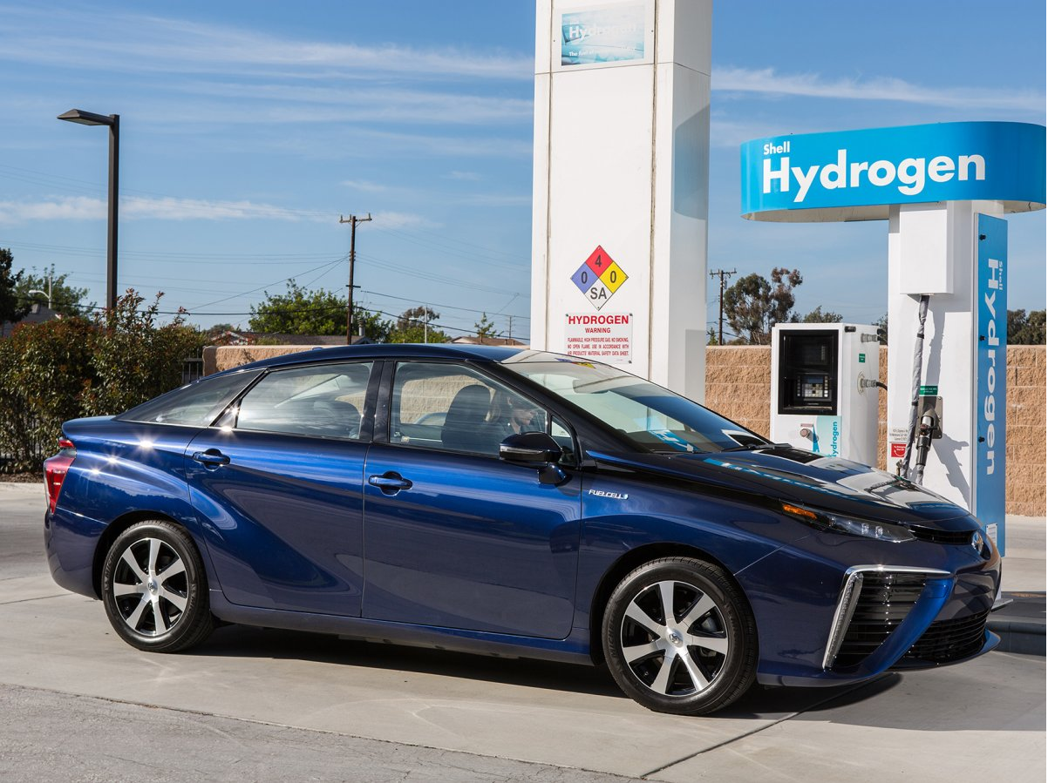
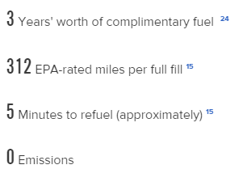
The Mirai gets an estimated 67 MPGe
Notes:
More recently, major OE’s have become more interested in the technology. Toyota and Honda have partnered with California and refueling infrastructure providers to help spread the infrastructure, beginning in California then with plans to build out the East Coast as well. I drove a Toyota Mirai last year and I have to say, its an impressive vehicle!

Slide 20
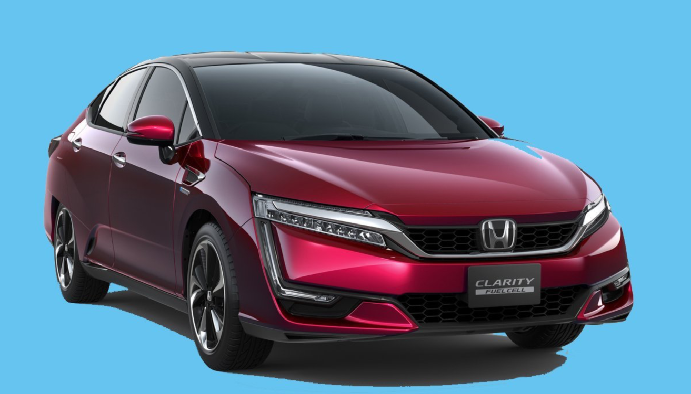
The EPA-estimated range is 366 miles and its fuel-economy rating is 68 MPGe.
Notes:
Honda, another investor in Hydrogen technology not only in its vehicles, but in partnering for infrastructure build-out, has launched the Clarity.

Slide 21
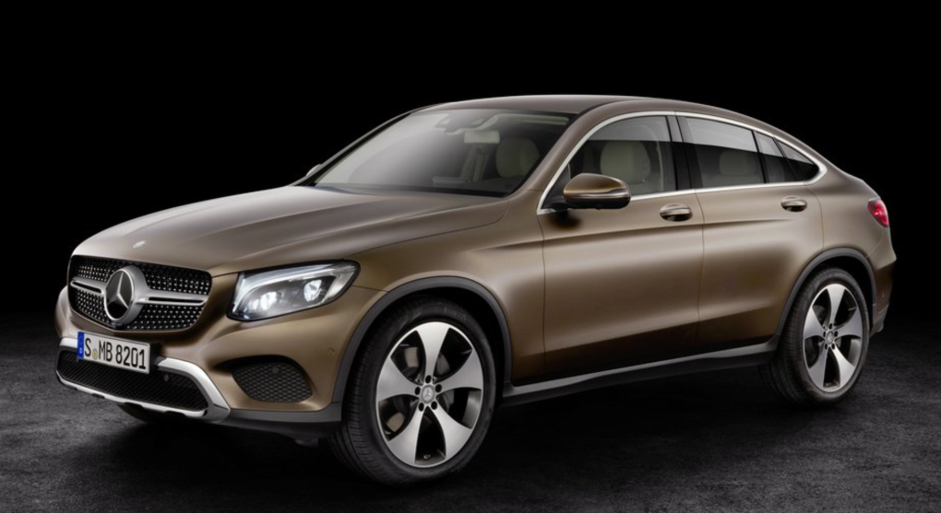
Notes:
Mercedes is making a plug-in hydrogen car called ghe GLC F-Cell. It will have an all-electric range of around 30 miles and a 310 mile range overall. It is expected in 2017.

Slide 22
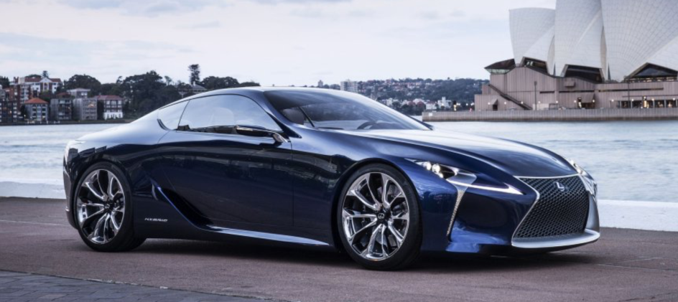
Notes:
Lexus plans to introduce a Hybrid model by 2020

Slide 23
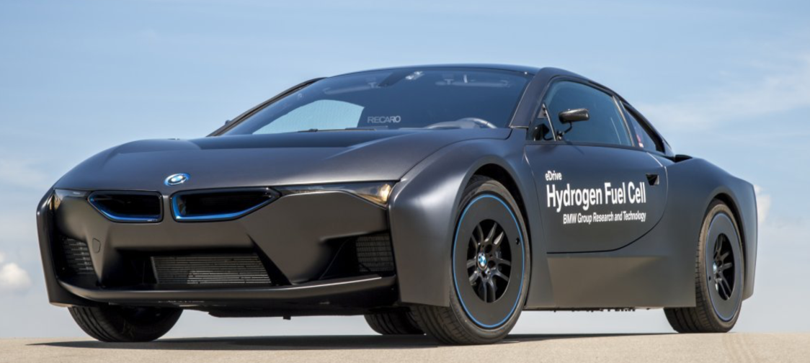
Notes:
BMW is working on a version for 2020…

Slide 24
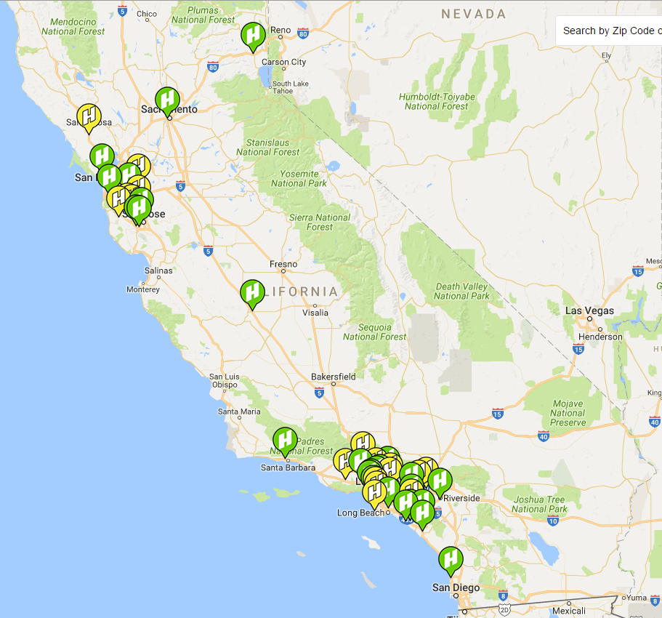
Notes:
And that single fueling station in 2004 has expanded to 26 currently open in California and another 15 in development.

Slide 25
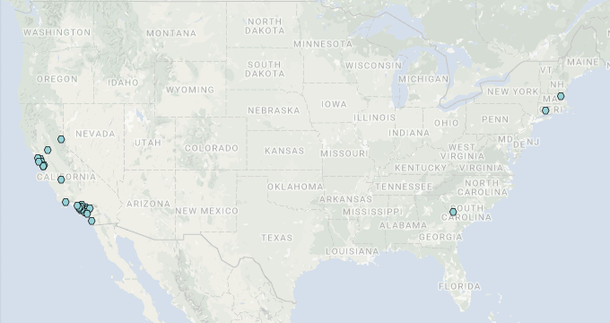
Notes:
But this technology still has significant hurdles until infrastructure, cost of developing fuel in an environmentally friendly way and end user cost of fuel is attractive.
On the plus side, this technology deals with the issue of recycling batteries and long recharge times – refueling a hydrogen vehicle takes roughly the same amount of time as fueling a gasoline powered vehicle.

Slide 26
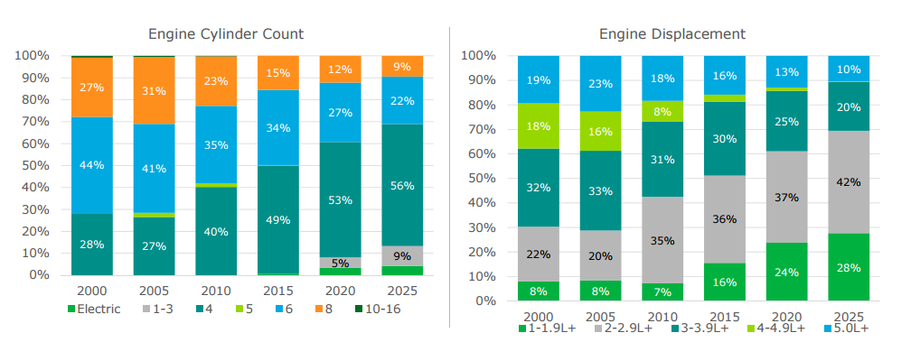
Cylinder Count and Displacement Shrinking
-22%
-22%
+29%
Notes:
So most of the efforts to meet the CAFÉ requirements center around the good old ICE engine for the time being. But these won’t be the engines we’ve been accustomed to!
First, Cylinders are shrinking.
Transition - The standard V-8, which has been the mainstay engine for years peaked at about 31% market share in 2005 and is projected to shrink by about 22% to 9% market share by 2025.
Transition – Even 6 cylinder engines, which peaked in 2000 at 44% of market share, are expected to drop to 22%.
Transition – while that is going on, 4 cylinder engines are continuing to amass more market share, and even 3 cylinders are expected to come back and be around 9% by 2025.
Transitioin – Not surprisingly, engine displacement also becomes smaller, although output per cubic inch will increase exponentially. Even now 2-2.9L engines make up the lions share of market and that is expected to increase, as well as an increase in the smaller 1-1.9L engines.

Slide 27
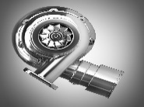
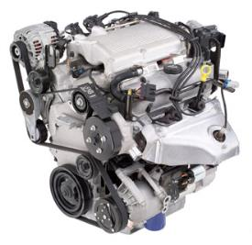
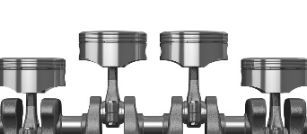
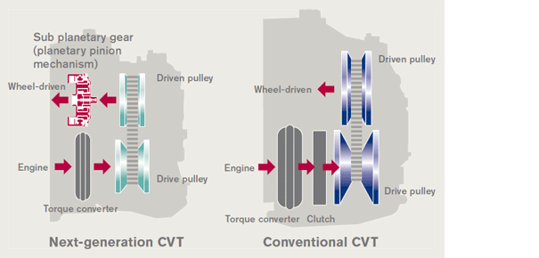
Revising the Traditional Internal Combustion Engine (ICE)
Gasoline direct-injection
Turbo chargers
Stop/start capability
Cylinder de-activation
AWD disconnect
More efficient transmissions
more speeds and CVTs
X
X
Notes:
We’re getting more power out of the smaller engines using more GDI with boost technologies. Across the board we’re adding technologies to get more power and economy out of smaller, lightweight powertrains.

Slide 28
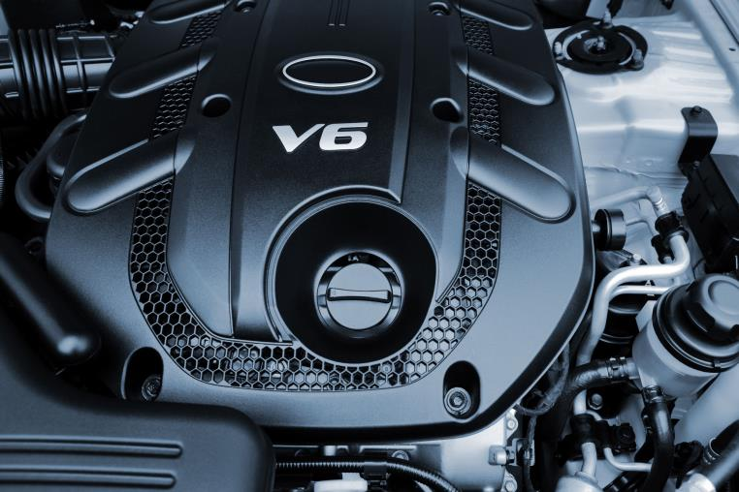
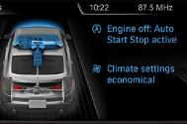
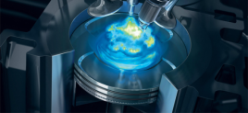
2 Technologies Become Dominant
50%
66%
by 2021
by 2021
Stop/Start
GDI
Turbo/Non-Turbo
16%
Today
26%
Today
Source: IHS Automotive
Notes:
And really 2 technologies become dominant by 2021 – mostly because they yield significant fuel economy possibilities and they’re relatively inexpensive to implement. When coupled together, as they generally are, the fuel economy benefits improve even more.
Big growth for both over next 6-7 years….not mutually exclusive…could have both.
But GDI, even with the benefits, brings its own share of problems to the powertrain – particulate emissions which can be potentially engine-damaging.

Slide 29
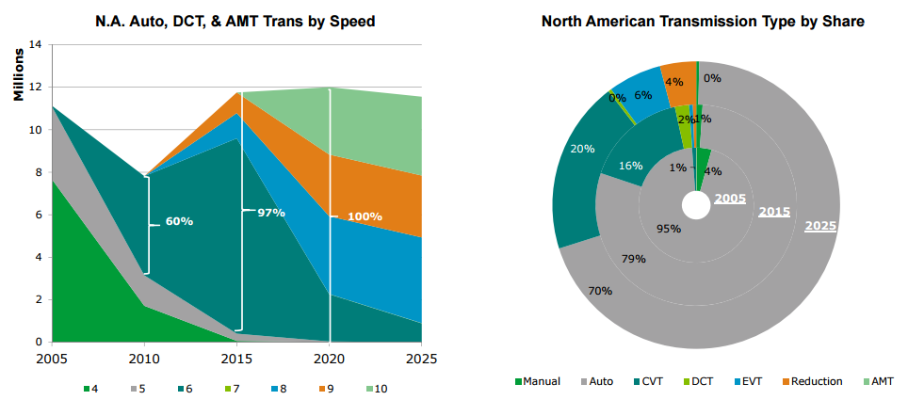
North American Transmission Production Increased Complexity, Greater Speeds
Source: IHS Automotive
Notes:
A more expensive but effective way to both manage performance of smaller engines, and to increase overall fuel economy, is to add transmission speeds and technologies.

Slide 30
Electrification Takes Hold Shift to Mild/Full Hybrids Starts Next Decade
Electrification is Required
Larger vehicle offerings require several solutions
Fewer options into the next decade
48V is an enabler though a learning/cost curve ensues
Low oil environment complicates
CARB electrification mandate complicates
Electrification = Stop/start, MHEV, FHEV & BEV
Source: IHS Automotive
Notes:
And the current plan is to continue to evolve what we call the “electrification” of the vehicle. Start/Stop, you can see, ramps way up from now through 2023, and we see hybrids making gains as well.

Slide 31
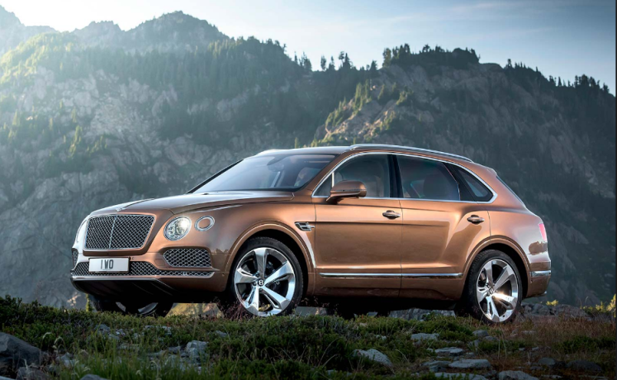
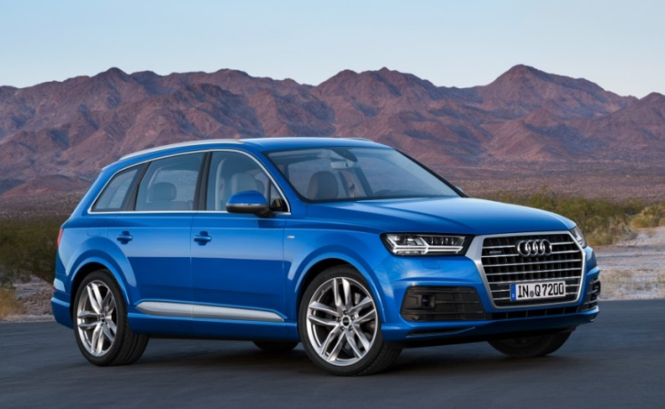
48 Volt is (finally) coming!
The Bentley Bentayga and Audi SQ7 TDI utilize the 48-volt system today – expected to spread into the mainstream in coming years
Notes:
48 volt electrical systems are coming back – remember when we talked about them in the 90’s?

Slide 32
48v Enables…
New infotainment options
Electric sway bar systems for better handling
Fans, pumps, electric power steering racks, compressors all running more efficiently
Benefits to wire-harness size and weight (smaller and lighter)
Potential to drive a car under only electric power and run AC without the engine on can result in major fuel economy and comfort-related benefits
Quickly heat up a catalyst in a diesel exhaust system to reduce emissions
Notes:
With electrification comes more current flow, which means heavier wires, which adds weight to the car and which is tough on those precious battery packs. Higher voltage electrical systems reduces overall current flow, allowing thinner wiring, reducing weight and improving battery life between charges.

Slide 33
48v – Enabling new hybrid Technologies
E-Machine on the gear output
Engineers expect the advent of 48-volt electrical systems to enable new mild hybrids that achieve 70% improvement in efficiency at only 30% of the cost of current hybrids.
P2 Configuration Hybrids are in production now in Hyundai Sonata hybrid and Infinity M35 hybrid. P2 allows decoupling of the engine from the driveline for temporary slow speed commutes.
Other OE’s who are developing P2 hybrids include Mercedes, Volkswagen, Toyota and BMW
Notes:
48v is also a less expensive alternative to provide mild hybrids which achieve 70% improvement in efficiency over a traditional ICE at only 30% of the cost. In addition the batteries aren’t so large and don’t add as much weight to the vehicle. Essentially the “P2” configuration seems to be getting a lot of traction, allowing clutches to engage or disengage the ICE for periods of time.

Slide 34
Spark plug “under fire”
Fuel Economy
Lean burn
Emissions
Locating fuel/air molecules
The 54.5 mpg CAFE requirement has caused the auto industry to re-evaluate their current ignition systems.
Experts believe that these new and future requirements can only be met by advanced ignition systems, and not by any current spark plugs.
One way to increase fuel economy and decrease emissions simultaneously is to ignite mixtures with less fuel under partial engine load conditions.
Current spark-ignited systems struggle with this, especially near idling speeds.
Complex, multi-stage catalysts are the norm for reducing greenhouse gases, hydrocarbons, and oxides of nitrogen (NOX) from emissions of typical internal combustion engines.
Most of these emissions are the result of ultra-hot ignition and incomplete combustion within the engine.
Because fuel is only ignited near the arc gap in a standard spark plug, a suitable fuel/air mixture needs to be present to ignite.
As mixtures get leaner and leaner, this becomes a growing problem.
Notes:
If that wasn’t enough, and this is more like 6 years + out, another area being looked at is the ignition system.
First, some engineers believe we’ve stretched about as far as we can with conventional spark plug ignition, especially as we try to hit 54.5 MPG CAFÉ Requirements.
Transition – Much of the technology we install to control emissions is patching a result of incomplete combustion within the engine
Transition – as we attempt to run engines leaner, we need to be abel to ignite mixtures with less fuel under partial engine load
Transition – combustion chamber design and the leaning out of mixtures desired makes the placement of the ignition more and more critical.

Slide 35
Spark plug elimination?
Laser ignition | Plasma ignition | Compression ignition
Burn fuel more efficiently. Cleaner and greener cars. Can be tuned more efficiently than spark plugs. | Completely burns all fuel inside the combustion chamber at a faster rate. | Has the benefits of a diesel engines, but runs on gasoline.
Extremely expensive. Have suffered from incomplete combustion. | A low-power solution is a long way off for plasma systems. | More difficult to control than other combustion engines.
6+ years (in progress) | 6+ years (in progress) | 6+ years (in progress)
Notes:
Three technologies are currently being explored to solve these problems
Laser ignition seems to be the front-runner, but are extremely expensive and the kinks are not yet worked out in how to achieve complete combusion across all engine loads.
Plasma ignition requires a huge amount of current – exceeding 20 amps – to operate. Even at 48 volts it is unclear when this could become feasible.
Compression ignition – think diesel applied to gasoline – combines the best characteristics of the Otto and diesel engine cycles. Its called Homogeneous Charge Compression Ignition (HCCI)
All of these are years out, but we felt it was important that you understand they are possible entries in the not too distant future!

Slide 36
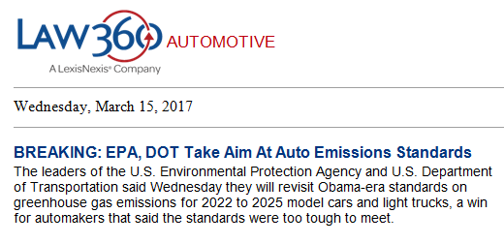
Changes in Regulation could change everything…
Notes:
Of course, much as the previous administration imposed those tough targets, the new administration is reviewing them. There is a review of the current standards underway, and at least some confidence there will be some relaxing of those requirements. However, since most OE’s have to develop for the global market, unless they follow our lead in relaxing standards, and since a lot of what we’ve been discussing is already in the development pipeline – I think most of what we’ve been discussing will continue to evolve. Especially since another new administration could re-reverse the rulings, reapplying the pressure for stricter emissions and fuel economy standards.

Slide 37
Drive for Safety
Notes:
One area that’s not likely to slow down is the application of technology in pursuit of a safer vehicle! The past 8-10 years has been an incredible ride with what we used to call the “electronics revolution” in the motor vehicle industry!

Slide 38
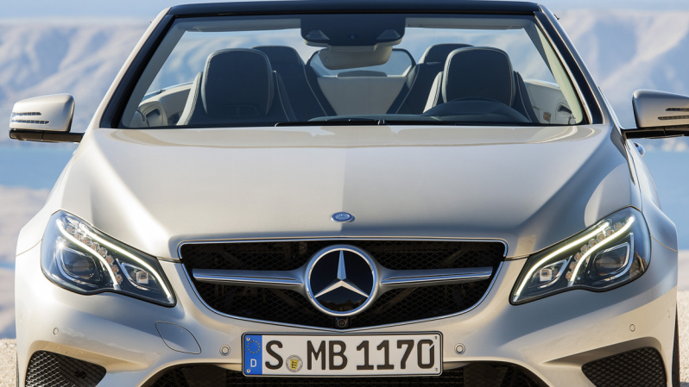
Getting Ready for The Accident Free Car Mercedes-Benz Sensor Arrays in S-Class, E-Class
stereoscopic multi-purpose forward camera sensors
infrared night vision sensor
additional sensors, ECUs
radar collision/ACC sensors
camera parking sensors
ultrasonic parking sensors
All part of the ADAS “explosion” – Advanced Driver Assistance Systems
Photo: Mercedes-Benz
Notes:
Adaptive cruise control and parking assist sensors used to be the hot item – first appearing in limited numbers in the ‘90’s! Then Blind spot monitoring began appearing in 2007.
Adding newer technologies such as infrared night vision, radar collision avoidance systems and sophisticated cameras have created a new industry category broadly referred to as “ADAS” – Advanced Driver Assistance Systems.
The Mercedes S-Class and E-Class both have about 25 sensors in just the forward array! Not including the many other new sensors being added all around the vehicle.

Slide 39
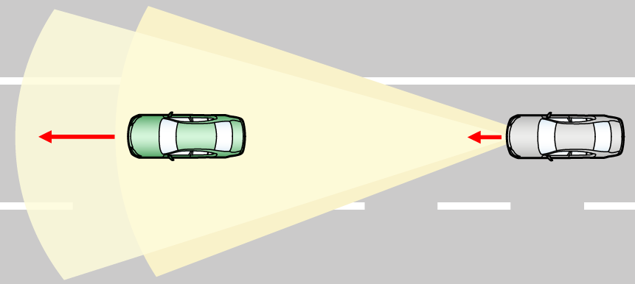
Getting Ready for the Accident Free Car
Forward Recognition Camera Detection Area
Vehicle or pedestrian
Radar Detection Area
Notes:
Up until very recently, most advances in these technologies have been in the hardware. We’ve tried radar, we’ve tried camera. Right now the highest accuracy seems to come from using both. While radar is preferred, it just can’t differentiate yet objects such as manhole covers and the like, so many manufacturers are using cameras to validate if a radar detects something before making adjustments to the vehicle operation.

Slide 40
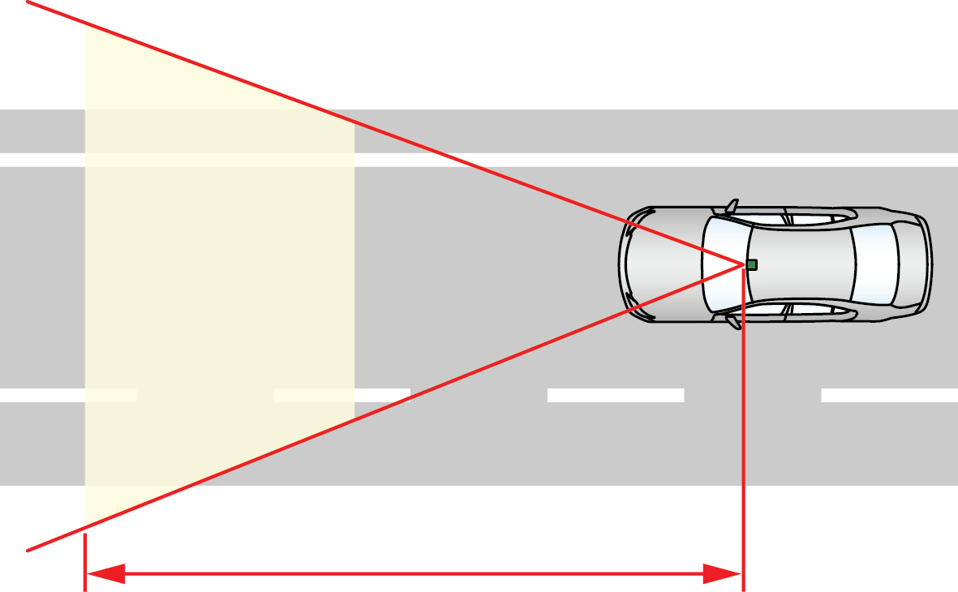
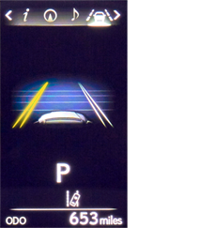
Getting Ready for the Accident Free Car
Image Processing Range
Approximately 164 ft (50m)
Notes:
Adding electronic steering also allows the system to use these cameras and radar to sense if the driver is wandering out of a lane, and alert him through visual, haptic and audio feedback.

Slide 41
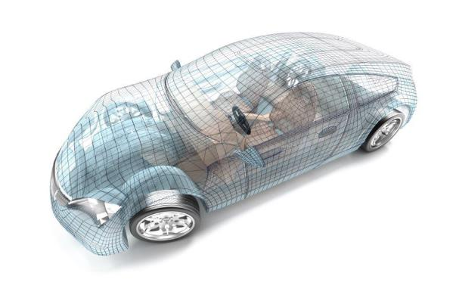
ADAS Sensor Technology Drives Increased ECU’s
TSR – Traffic Sign Recognition
HBC – High Beam Control
ACC – Adaptive Cruise Control
Radar Module (Secondary)
Additional Data Processing Module
Supplier: Bosch
Applications: LDW, ACC & TSR
Supplier: Hella
Applications: BSD
Radar Module (Primary)
Front-view Camera Module
Supplier: Hella
Applications: BSD
Supplier: Bosch/ Continental
Applications: LDW, ACC, TSR & HBC
Night Vision Camera Module
Camera Module
Supplier: Autoliv
Applications: Night Vision
Supplier: Kufatec
Applications: Surround-view Park Assist
Radar Module
Night Vision Control Unit
Park Assistance ECU
Supplier: Bosch
Applications: ACC
Supplier: Autoliv
Applications: Night Vision
Supplier: Valeo
Applications: Park Assist
Notes:
All these components make possible some level of ADAS – Advanced Driver Assistance Systems – which will ultimately lead to the fully autonomous vehicle.
With the advancement of ADAS – we are seeing not only an explosion in the number of sensors, but also the number of ECU’s – or mini computers being included on new cars today.
No longer just one sitting under the hood running your fuel economy, but they are now all around the vehicle controlling many different systems including Cameras, Radar systems, Night vision systems and parking assist system.

Slide 42
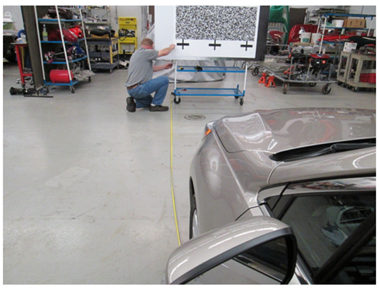
Calibration is critical!
Example: The Subaru EyeSight system divides the printed patterns on the random chart into about a thousand sections and measures the distance to each section
Notes:
As you can imagine, the calibration of these systems is critical! Here is just one example, but there are several calibration routines which vary widely by manufacturer. Some are as easy as printing targets on your own printer and placing them in areas in the shop – measurement is often critical. Others require targets mounted to fixed mounts on an aligner or stand-alone frame with specific level floor specs to insure the calibration will be accurate.

Slide 43
The Government wants to help…
Notes:
As we’ve discussed, much of this technology is driven by regulation – if the government requires it, we generally get it. The Intelligent Transportation System is a program which has been underway for years and has quietly been guiding and reacting to the technology gains made in vehicle technology…

Slide 44
The ITS Connected Vehicle (V2V/V2X)
5.9 GHz two-way radio and GPS-based technology
Also called Dedicated Short Range Communications (DSRC)
Allows a vehicle to “see” other vehicles beyond the range of radar, cameras and other sensors
Enhances existing ADAS
Allows low cost vehicles to have ADAS features
Projected by NHTSA to help in 80% of non-impaired crashes
Great potential for aftermarket retro-fit
Connected Vehicle as defined by the US Department of Transportation (DOT) Joint Program Office (JPO)
Notes:
The ITS vision, simply, is to make sure the vehicles, infrastructure such as traffic lights, train crossings etc. and pedestrians, are all aware of each other, aware of conflicting interests and aware of countermeasures available to them. This awareness across the stakeholders can reduce accidents, both vehicle to vehicle and vehicle to pedestrian, and increase fuel efficiencies by better managing the flow of traffic. We’ve all done it, right? You come to a stop light, have it turn red just before you get there. You stop, and there’s no one coming in the cross lanes. What if the light would never turn red in the direction you’re travelling unless there was a reason to? Imagine your car signaling you that a car 500 feet ahead of you around a blind turn just slammed on its brakes? The technologies driving this have been in development for years.

Slide 45
NHTSA’s Proposed V2V Mandate
NHTSA’s V2V Notice of Proposed Rule Making (NPRM) that will require DSRC technology on all light vehicles sold in the US was officially released in January 2017
The V2V systems must be able to:
Transmit and receive the standard Basic Safety Message (BSM) to and from surrounding vehicles
Receive Over-the-air (OTA) software and security certificate updates
MEMA is currently working with members on comments for submission to NHTSA
Notes:
This has been in various stages of testing for a number of years now, and NHTSA has started the process of mandating it – as of January this year they are pushing for final public comments before making it an official mandate for the OEMs.

Slide 46
NHTSA V2V Phase-in Timing
Proposed phase-in begins 2 years after final rule
50% of new light vehicles (<10K GVWR) required to be equipped by the end of year 3
75% by the end of year 4
100% by end of year 5
If the rule is adopted in 2019, the phase-in would begin in 2021 and all light vehicles would need to comply in 2023
Notes:
This is the phase in plan – the assumption is there is still a lot of dialogue between the stakeholders and NHTSA, and we assume the actual rule would be adopted in 2019. It could happen sooner than that, so adjust the phase-in math appropriately!

Slide 47
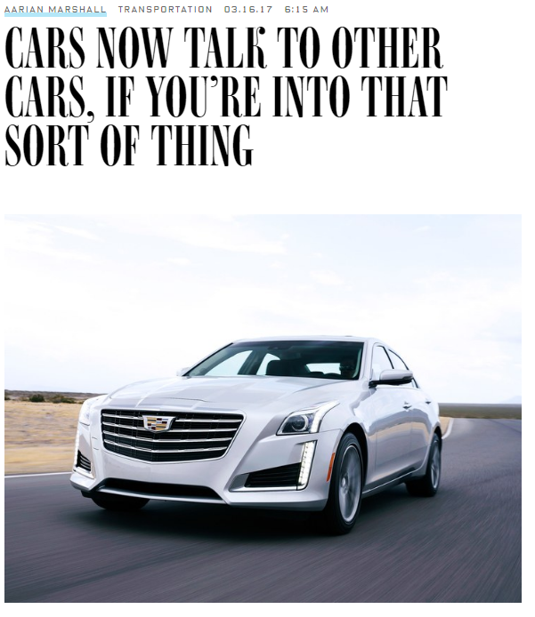
Notes:
Meanwhile, GM is already producing vehicles with V2V technology. Today it’s a bit worthless as Cadillac CTS’s can only talk to other CTS’s and let’s face it, there aren’t that many of them out there. It’s a little gutsy, as there are no guarantees Cadillac’s implementation will meet the requirements of the final NHTSA ruling, but either way they’re paving the way!

Slide 48
So where’s the self-driving car?
Notes:
As we’ve discussed, much of this technology is driven by regulation – if the government requires it, we generally get it. The Intelligent Transportation System is a program which has been underway for years and has quietly been guiding and reacting to the technology gains made in vehicle technology…

Slide 49
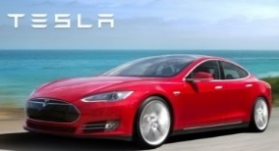
Define “Self-Driving”…
L5: Self-driving Only
Self-Driving Car Only
L4: Full Self-driving
Self-Driving &
Human-Driven Car
L3: Limited
Self-driving
Auto Pilot: Parking
Auto Pilot: Highway
Park Assist
L2: Partial Autonomy
Autonomy of 2 primary control functions = Traffic Jam Assist
Adaptive Cruise Control
Lane Keep Assist
L1
Autonomous Braking
Autonomy of 1 primary control function
Adaptive Cruise Control
2010 2015 2020 2025 2030
Full Driver Control Driver Assisted Fully Autonomous Car
Notes:
So with all the ADAS initiatives and the pseudo-self driving cars out there, when do we finally get the self-driving car? Well, autonomous, or self-driving, vehicle’s levels of autonomy vary.
Level 1 of autonomous controls have been around for a while – that includes autonomous braking (collision avoidance) and adaptive cruise control.
Transition – Level 2 adds features like park assist, enhanced adaptive cruise control and lane keep assist. Those features are becoming more commonplace today.
Transition – Level 3 adds “Auto Pilot” features which does allow the car to drive without hands on the wheel with supervision – in controlled situations where there aren’t white semi trailers in front of you!
Transition – Level 4 is the next big leap and will allow you to “give control” to the vehicle, and distract yourself. Level 5 actually allows you to take the steering wheel out of the car if you wanted to (think Uber driverless vehicles).
Since we have all the components in place, why can’t the cars drive themselves – at least at an L4 category – today?
There are a variety of technology barriers still keeping that from happening – they are being addressed quickly and we’ll talk more about those in a minute.
Meanwhile, assuming the technology gets proven, lots of other questions have yet to be answered:
In a true L5 car, can you get a DUI?
In a true L5 car, if it gets in an accident, who is at fault?
Even in an L4 car, lots of questions to be decided about when the vehicle “cedes control” to the driver…
What are the implications to current vehicle platforms?
As we wrestle with these issues, there is still the prediction of societal acceptance of the autonomous vehicle. In a recent Goldman-Sachs study, societal acceptance is listed as still one of the highest barriers to entry for the true AV.

Slide 50
Self-Driving Light Vehicle Forecast: Global Annual Sales
HDC = Human Driven Car
SDC = Self-Driving Car
Source: IHS Automotive
Notes:
IHS Markit predicsts a rollout per this chart.
Growth really begins at about 2025…but pretty negligible at that point
By 2035 – nearly 12 million total global sales…less than 1% of total global sales

Slide 51
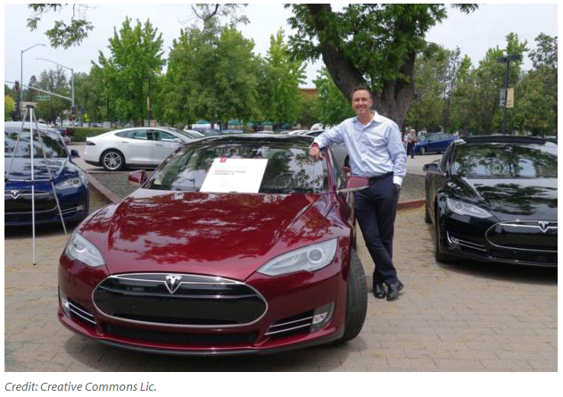
Notes:
Many OE’s are pushing hard to accelerate that timeline! Based primarily on a challenge by companies like Uber and Lyft who would love nothing more than to remove the low-paid drivers they are already paying…and are apparently willing to spend millions of dollars to do it.

Slide 52
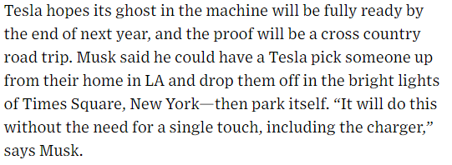
Notes:
Tesla says the components are in place now.

Slide 53
Notes:
While this video shows a bad Tesla example – remember, Tesla has not claimed you can take your attention off the road in Autopilot mode – it should also make us think about the challenges of all the variables involved in driving – things we take for granted, but which are difficult for a car’s computer to deal with!
There have been recent developments in Artificial Intelligence – AI – which promise to help accelerate trying to anticipate these things…

Slide 54
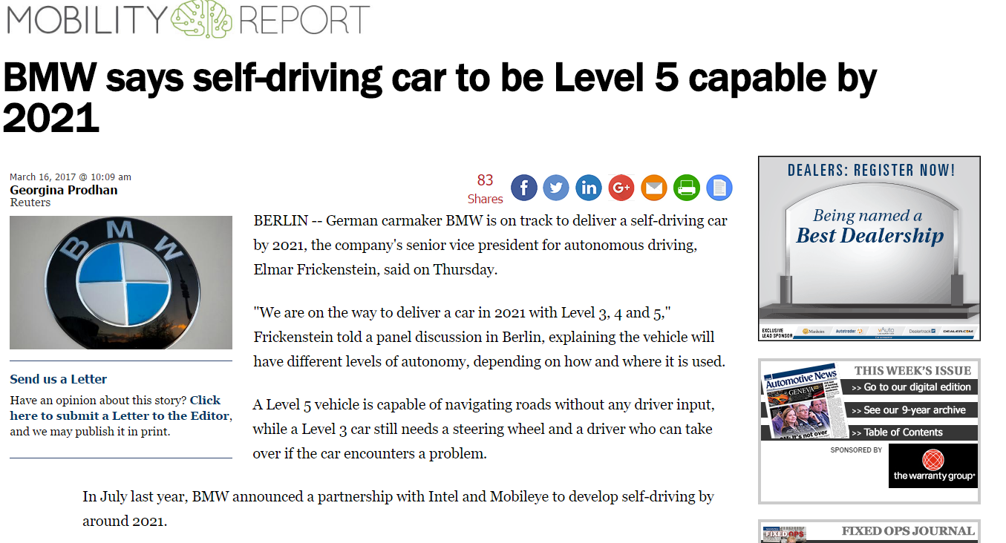
Notes:
And BMW is pushing hard for a 2021 L5 vehicle.

Slide 55
Autonomous Vehicle Outlook
Building Blocks of Autonomy Offer Compelling Near-Term Growth Prospects
ADAS Applications Leading to Autonomy – Worldwide Production Units
Source: IHS Automotive
Notes:
Regardless of exactly when the L4 and L5 vehicles really become commonplace, one thing is for sure. The components that are now proliferating these vehicles as ADAS applications are going to make our highways and vehicles safer! And they add a lot of complexity that, when it starts wearing out, will require someone to service it!
Meaning we must be ready with the information – and companies like mine and others are working hard to insure we have that information available and easy to find. The calibration and diagnostic routines need to be included in tools the professionals can acquire reasonably – and we need to educate the consumer that we remain ready to service these vehicles – as we always have been.
So what keeps us from having an AV vehicle today? We have all the pieces. Two key issues remain:
Redundancy
Programming

Slide 56
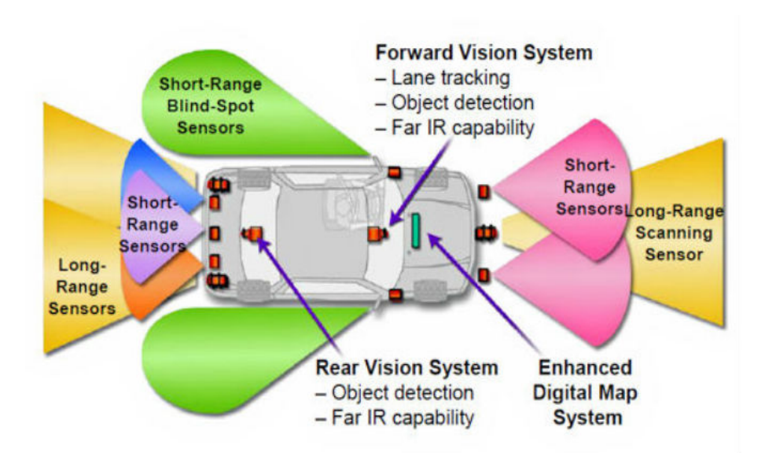
+
AI
Notes:
Remember this slide? Three things take this picture of a fully ADAS-equipped vehicle and make it a true Autonomous Vehicle:
As mentioned, the hardware is there. What isn’t necessarily there, and hasn’t been fully vetted, is the need for redundancy. Many of you flew to be here today, and most of your aircraft pretty much flew themselves. There is still a pilot who is not allowed to take his or her eyes off the controls – that is one level of redundancy. The other in aircraft is for pretty much every control servo which helps steer the plane, throttle up the engines etc. there is a redundant system. If both systems don’t agree on specific values, they return control to the pilot for making critical flight decisions. In the automobile, so far as I know we have redundancy in some systems – most drive by wire systems have at least two TP sensors, for example, and they must agree on their interpretation of the throttle angle. But to have two EPS systems in case a motor malfunctions, or to have redundancy in many other areas adds cost and weight to the vehicle, further putting into question when we can truly “remove the wheel” and make it a full L5 vehicle.
Connected vehicle services – we have those today, but they will have to be even more robust and real-time, to connect the vehicle to infrastructure. Because if you drive a car – I assume most of us do. It doesn’t really matter whether you’re a “car person” or not. Whether you’ve ever popped the hood release and looked under the hood or not, when your car is not behaving as you’re used to, you notice it! You take off from a red light and it shudders a bit, or hesitates. Or stumbles when you bring it back to idle. Or whatever it might be. Think about the day when you are no longer at the wheel with your feet on the gas and brake pedals. We will lose that “tactile connection” with the vehicle. So as it begins to hesitate taking off from a light, internal sensors and algorithms, likely tied to external data sources for real-time research of an issue, will all be taking place without our knowledge. The vehicle itself – picture it as a future Uber car – will have to decide if it can safely deliver its payload – could be you – to your destination, or if it needs to pull into a maintenance garage to have something checked out. Does it decide it can deliver you, then take itself “out of service” and drive into a maintenance garage – or should it pull over as it can’t safely drive itself, and call for a tow-truck and a replacement vehicle to deliver you? All these things will be happening in a connected manner. With high computing processing occuring both in the vehicle and in the infrastructure the vehicle is communicating with.
Transition – and recent advancements in AI – Artificial Intelligence – is what is really driving the accelerated timelines. AI promises to “learn” rapidly and be able to help process that information and help make decisions. This will be critical for the success of the AV.

Slide 57
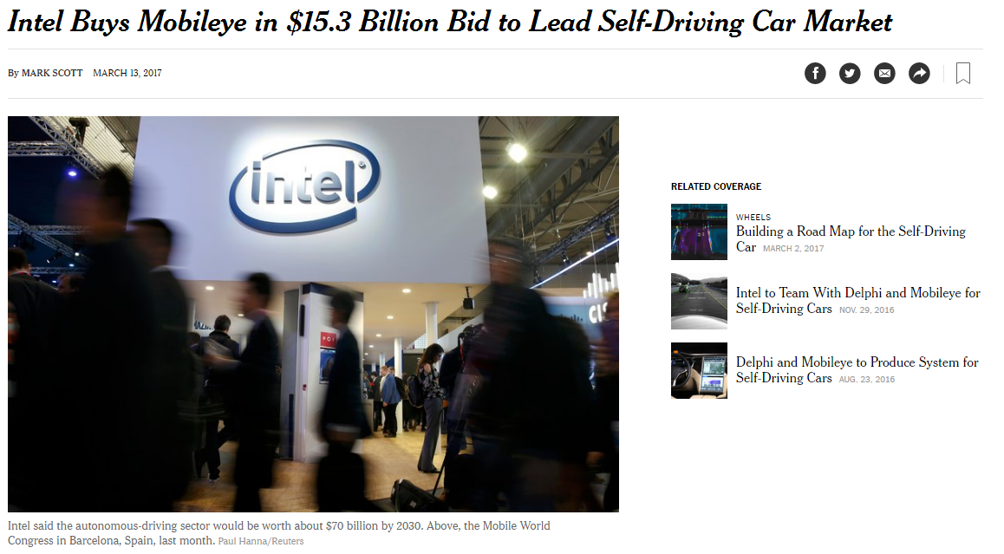
Notes:
Mobileye has been deemed so important, it became a necessary acquisition – valued at over $15 billion dollars – for Intel to target to cement Intel’s future in the automotive mobility sector. During the purchase announcement, Intel believes the autonomous driving sector will be a $70b industry by 2030. If they’re right – and so far we don’t see data to state they’re not - $15b becomes a pretty good price if the Mobilieye/Intel technology partnership can maintain their lead.

Slide 58
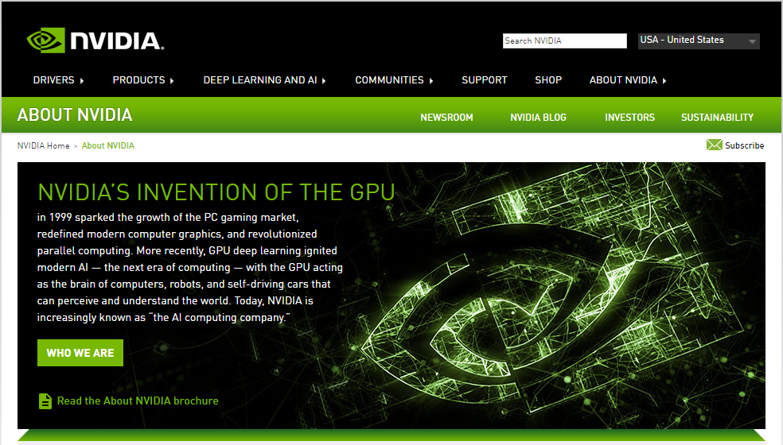
Notes:
Nvidia is another interesting story. Talk about a company who developed a technology for one use and recognized the potential in other uses! They invented the GPU – Graphic Processing Unit and the “Deep Learning” capability of the GPU.

Slide 59
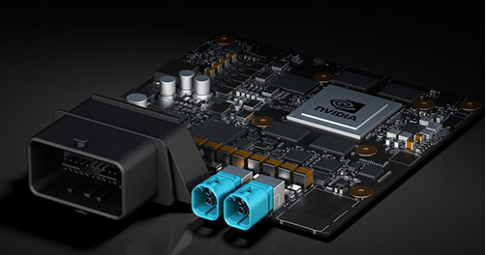
Notes:
Capable of only drawing 10 watts of power, a board with two GPU’s can deliver 24 trillion deep learning operations per second. And they’re scalable if you need more than that!
AT CES 2017 they announced their new Xavier chip which promises even more computational power. And they’ve build their own autonomous vehicle which they call the BB8 to test this technology. Let’s take a look!

Slide 60
Notes:
Pretty incredible, right? Think about all the decisions that are being made all the time – which lane is best to be in, anticipating all the vehicle’s intentions around you – all the things we do every day but take for granted.
Now let me paint a different picture! How many of you use an in-dash navigation system? Even if its your iPhone or Android phone? How many of you are married? OK, how many of you can relate to this – here’s how my life works – I have a navigation system and I use it all the time because it has a better view of the world from a real-time traffic scenario, so I let it route me around accidents and traffic congestion – it works pretty well! Unless my wife is in the car. Then its like “Why is it telling you to turn here! Turn left over there. Ignore that thing!” Can anyone relate to that? So I can’t wait for the day when I let my wife argue with the autonomous vehicle about the route it has her on trying to get her to an event. Should be pretty entertaining!
But seriously, a lot is going on in the world of AI right now. At my company we use it to deliver better information for diagnostic repairs and for connected vehicles to use as part of their decision-making process!

Slide 61
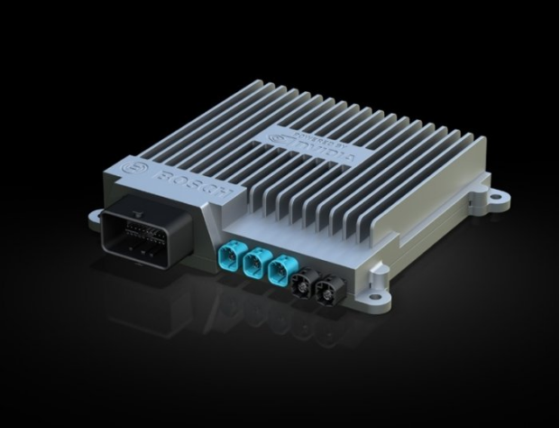
Notes:
And if you may not associate Nvidia with the motor vehicle market today, you certainly recognize Bosch – and they’ve signed up in a partnership with Nvidea to marry their knowledge of the automotive data structure with Nvideas Xavier GPU board to do some truly awesome things – and I can’t wait to see what they come up with next!

Slide 62
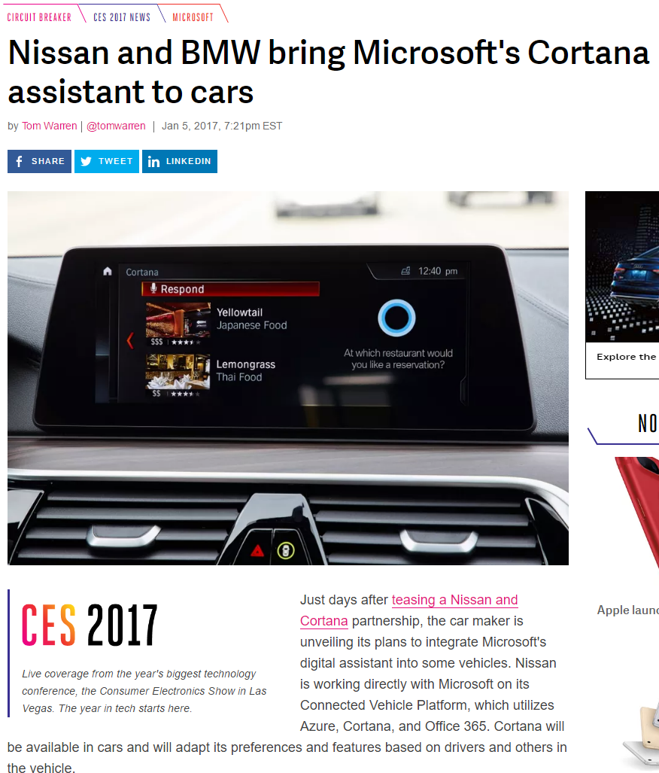
Notes:
Both Nissan and BMW have announced partnerships with Microsoft to bring Cortana’s consumer-centric AI functions to the automotive experience. With focus on natural language speech interpretation and converting that speech to action, more interesting possibilities emerge. Again at CES this year, Nissan had prepared a version of a possible vision they see for the Cortana integration to Nissan automobiles.

Slide 63
Notes:
So again, while this enhanced connection between the vehicle and the driver is not “autonomous” – it certainly shows the importance of the connections being established between the driver and the vehicle, as well as the vehicle to whatever infrastructure the consumer is using to manage the rest of their life – whether that’s through iCloud, Exchange, Google or another – the car knew the driver’s business appointments, personal information, etc.

Slide 64
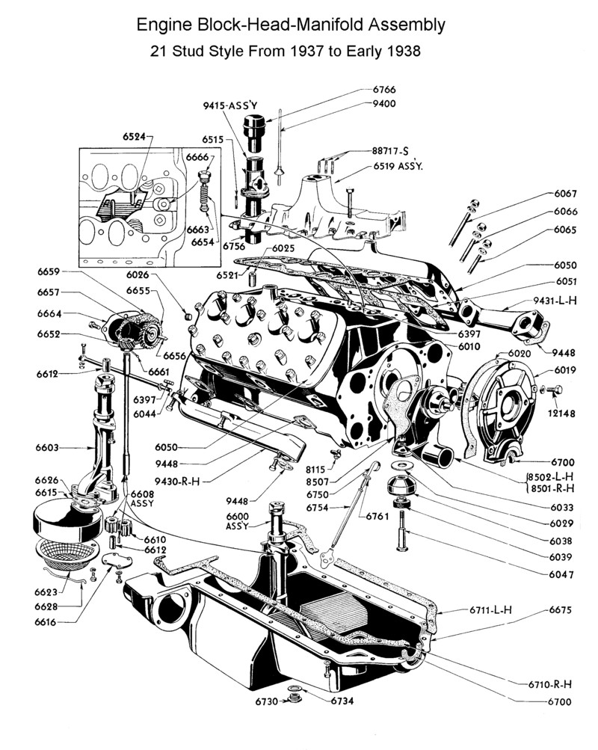
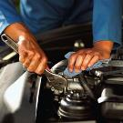
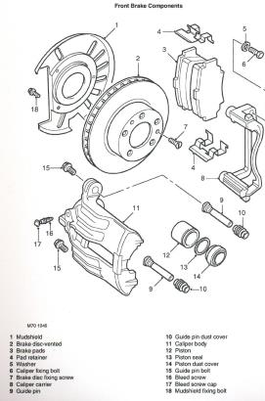
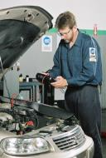
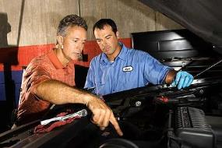
Aftermarket Faces a Challenge
Notes:
We’ve been here before! But not at this level of rapidly evolving sophistication.
When we moved from points ignition to transistor ignition to distributorless to direct ignition…
When we moved from carburetion to fuel injection…
The demise of the aftermarket was predicted by some…

Slide 65
Consumers Must Have Confidence
The Aftermarket Industry has the needed parts & technicians to service this new technology.
Notes:
Consumers must be confident that the independent AM can service these new vehicles just as effectively and more cost efficiently than the OEM dealer.
So whether it’s new electronics, alternative powertrains, or new technology surrounding the good old internal combustion engine…the aftermarket has the opportunity to do what it has done before…
Develop new, innovative solutions to the complexities associated with next generation vehicles.

Slide 66
The Connected Car & the aftermarket
Notes:
So lets talk more about connected cars! We’ve talked about them in the context of ITS, but there’s much more!

Slide 67
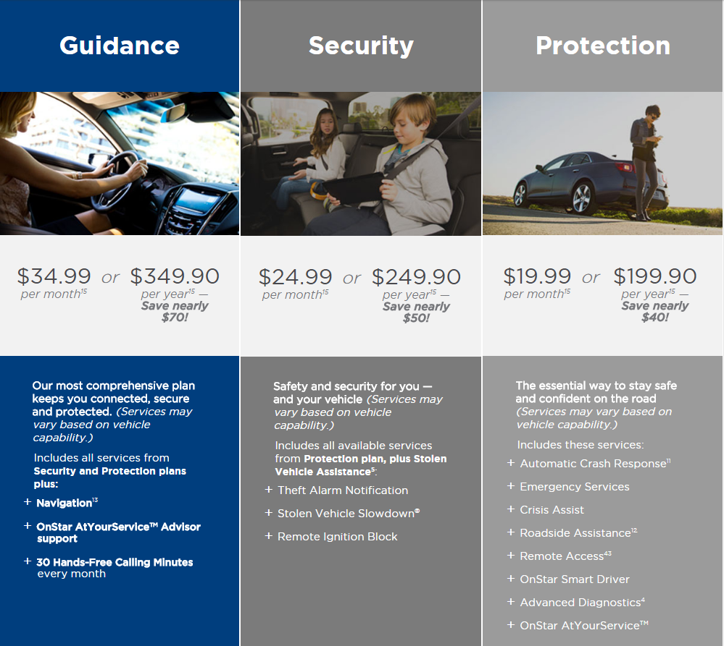
On-Star
Notes:
On-Star, as I said, has been a pioneer in turning telematics into an industry.

Slide 68
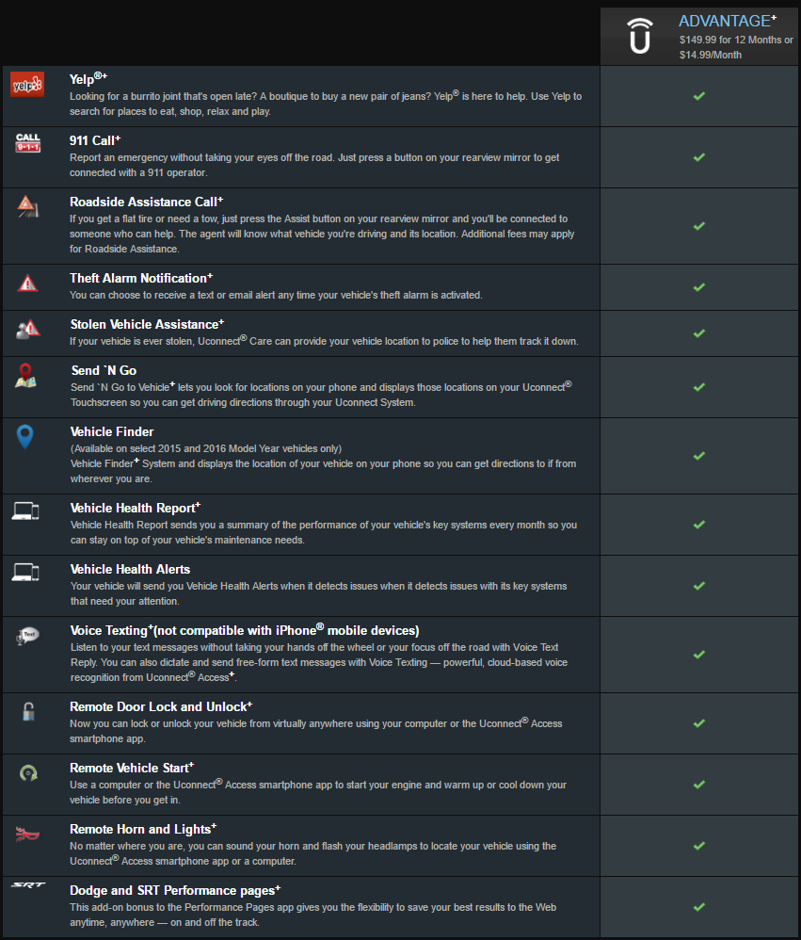
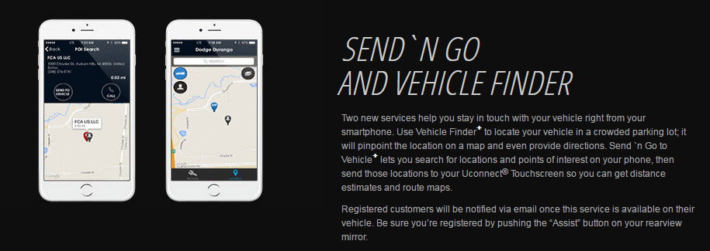
FCA UCONNECT ACCESS
$149.99/year
Notes:
Other manufacturer’s are following suit, trying to cash in on the OnStar model.

Slide 69
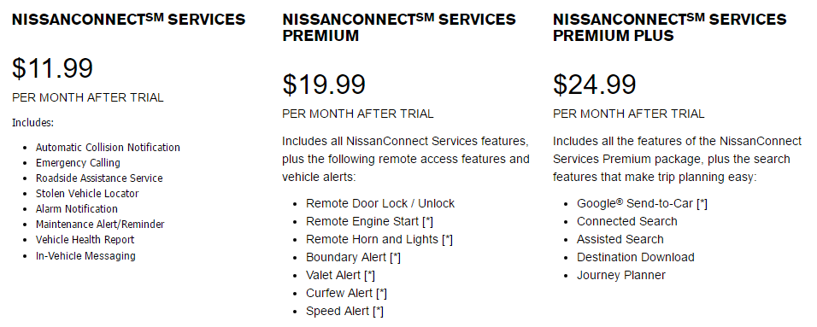
NissanConnect
Notes:
Others recognize the value of remaining connected to their customers, at least for a while at no charge.

Slide 70
Toyota safetyconnect

Slide 71
Mercedes-Benz mbrace

Slide 72
BMW ConnectedDrive

Slide 73
Aftermarket Telematics
Notes:
Then of course we have aftermarket telematics devices. These entrepeneureal companies have recognized the possibilities of telematics, put their own spin on it and are actively marketing solutions which leverage the standard OBDII (J1962) port on the vehicle.

Slide 74
Insurance Telematics
Notes:
Used not only for vehicle maintenance, but also for other stakeholders, insurance has the most aftermarket devices currently installed.

Slide 75
Security Concerns over Connected Cars
Notes:
And we’ve all seen recent issues as cyber-security hits our industry in a big way. So lets talk about that! Security is not a new issue for the vehicle manufacturers. It literally blindsided them. In 2014 I was on a vacation and needed to go to the store for something. My sister-in-law had used the rental car and I wasn’t sure where she had parked it so when I got into the parking lot of the hotel we were staying at, I hit the panic button to find it. Three cars in the parking lot began honking their horns, and one started. So this is not new – and it wasn’t telematics which started it. However, as the vehicles become more connected, obviously the risk platform increases.

Slide 76
Vehicle Hacking is a Real Threat
Threats from nation-states (asymmetric warfare, economic damage) and individuals ($$, theft or fame)
OEMs, suppliers and the government are working together to fully understand the potential attack surfaces involved and stay ahead of the threat
Vehicle cybersecurity will be a serious issue - forever
The industry is moving to secure-by-design architectures
Notes:
So vehicle hacking is a real threat! With the connected vehicle being so prevalent now, threats from outside countries wishing to do us physical or economic damage have but to hack into, for example, every on-star equipped vehicle in the US and shut them down during rush hour to clog our nations roadways and create an opportunity for more ominous threats.
Equally concerning are the software nerds who would just get a kick out of saying they drove all FCA vehicles off the road and take credit for it.
The vehicle manufacturers are working with government and security specialists to understand the threat footprint and countermeasures which can be taken to reduce the threat.
This will be something we face forever, just as we all have anti-virus software on our computers and many of us have had at least one instance where a virus snuck through
The industry is working together to design secure-by-design architectures, but they’re a ways off.

Slide 77
The OBDII Port – a History Lesson
Notes:
And while the aftermarket devices haven’t been singled out – as I said the VM technologies are pretty shaky in this regard – we certainly have an expanded risk with the dongles. First, the OBDII port was never intended for this! Since 1996 this standardized port has been required to access emissions-related data and codes from the vehicle. As we all know OE’s typically also use this connector for their proprietary communications which is not necessarily standardized but is fairly easy to figure out, either by reverse engineering or licensing from the OE’s the data and functions they make available.
It was designed for diagnostics in the service bay, not for remotely accessing vehicle information or potentially receiving inappropriate actuator requests etc.
Companies like VW have for a long time stated the OBDII port “was never intended as our playground”.

Slide 78
Notes:
Interestingly, even as some OE’s continue to tout the woes of the OBDII port and its exposure, Ford recently announced they will be marketing a device to retrofit older cars which includes remote start, lock and unlock functions and more.

Slide 79
Security Concerns Increase with Telematics “Nomadic Devices”
Notes:
Either way, by design we know the OBDII port is not secure. That means once the port becomes used for wireless access via one of these (or any of the nearly 500 offerings out there), the vehicle is as secure as the device plugged into it. We as consumers have no idea how secure they really are, but if someone gains access to them, they have access to your vehicle just as surely as if they’d connected directly to it.
The government is taking this seriously, and is pressuring the vehicle manufacturers to better protect us from ourselves by securing the OBDII port.

Slide 80
How this could affect you?
There is an SAE standards committee (J3138) to provide industry guidance in securing the OBDII port from cyber-attack
The implementation could severely impact diagnostic scan tool access to critical data from the port
ETI, Auto Care, MEMA and other trade associations are participating to insure the “voice of the aftermarket” is heard in this dialogue
Notes:
You might be asking “What does this have to do with me? After all, I’m not working on that many connected cars yet!
Well, there is an SAE committee that’s been meeting to provide recommended practices for the vehicle manufacturers to begin locking down the port.
Transition – How they do it could impact your scan tool’s ability to access critical data and functionality needed to properly diagnose the vehicle.
Transition – Industry trade associations are working to make sure the aftermarket’s voice is heard – but it could mean higher prices for scan tools due to new technologies needed, or worse yet, limit of access to certain functions.

Slide 81
Two Issues are ahead of us which affect us all
How does the consumer choose who has access to the data transmitted from their vehicle?
How do we secure the OBDII port?
Notes:
So we have 2 issues to solve:
We believe the consumer has the ultimate decision as to whether they want anyone getting the data coming off their vehicle, and if so, who should that be?
We need to secure the vehicle to protect the driver from unscrupulous hackers.

Slide 82
Secure Vehicle Interface (SVI) concept
Notes:
In a fairly historic event where the aftermarket and vehicle manufacturers appear to agree in principle on something, we’re jointly defining a solution we hope will help keep the aftermarket’s interests intact, give the consumer more choice about who has access to their data and not cause grief to the vehicle manufacturers.

Slide 83
The ITS Connected Vehicle (V2V/V2X)
5.9 GHz two-way radio and GPS-based technology
Also called Dedicated Short Range Communications (DSRC)
Allows a vehicle to “see” other vehicles beyond the range of radar, cameras and other sensors
Enhances existing ADAS
Allows low cost vehicles to have ADAS features
Projected by NHTSA to help in 80% of non-impaired crashes
Great potential for aftermarket retro-fit
Connected Vehicle as defined by the US Department of Transportation (DOT) Joint Program Office (JPO)
Notes:
Remember the ITS proposal? And how its fairly certain to become mandated?

Slide 84
ISO Secure Vehicle Interface (SVI)
Manufacturer Network Mapping
Aftermarket
Solutions
Notes:
This is a high level view of the ITS architecture – its already going to be in place to support ITS – and it allows the possibility of an aftermarket interface securely requesting functions and data from the on-board computer systems on the vehicle.
Not to oversimplify, but essentially the aftermarket, SAE and the vehicle manufacturers must agree on a common set of requests that can be made which will allow this thing in the middle – the vehicle gateway – to receive the request, determine if the vehicle is in a state to respond to the request, and then respond back to the requestor.
It actually makes the OE systems more secure, because aftermarket companies will no longer need to understand all the stuff that happens to the left of that box like they do today.

Slide 85
ISO Secure Vehicle Interface (SVI)
Notes:
To simplify further, we’ll be able to access either via an OBDII port or wirelessly through telematics interfaces through a built-in firewall to the SVI. The firewall will authenticate the tool as valid, but more importantly the SVI will take any request which is defined in its data dictionary and pass it back to whatever VM-specific protocols may be behind it. We don’t know and really shouldn’t care how they designed it in the background AS LONG as we have a robust data dictionary which is updated as new systems are added to the vehicle. This way we can ask at any time to take control of the steering wheel. The SVI will process that request and, based on the data dictionary and the rules which govern it, can respond with:
I could do that but not unless the vehicle is stopped and in Park or Neutral
I can’t do that based on the situation at hand
This vehicle does not support that function
Etc.

Slide 86
Industry Association Efforts
Auto Care Association, Automotive Aftermarket Suppliers Association, ASA, ETI and others are working with VM’s to establish agreements
Notes:
So what can we do? As an industry we’re represented by a variety of industry trade associations. AutoCare, AASA, ASA, ETI and others are collaborating well on this subject and are working as a team with the VM’s to arrive at a mutually beneficial solution which keeps the aftermarket relevent. They’ve had a few productive meetings and are scheduling what may be the most inciteful meeting in November where the techies can finally get together and begin hashing this out. We remain hopeful these meetings are productive and we get alignment by all the VM’s on the SVI approach.

Slide 87
Notes:
In the meantime we have commissioned a very extensive survey of industry folk and people who drive the cars to get their takes on telematics and what it might mean to them, because at the end of the day this is not a dialogue about “aftermarket vs OE” – instead, this is an argument about “who owns the data” and “who dictates who has access to the data”.
You have a copy of these next few slides in your handouts as we felt it important for you to become familiar with this subject, as you’re likely to hear a lot more about it in coming months. I want to cover some highlights:

Slide 88
Notes:
First, not too surprisingly, consumers are not all that aware of the subject of telematics. Over 60% of them have no knowledge at all.
Transition – second, more interestingly, in the Auto Care Association’s member roster, only 24% consider themselves very familiar with the subject and roughly 75% of them might have heard about it but don’t know all that much. So I can tell you, at the Auto Care Association we’re taking that pretty seriously and are embarking on a significant education campaign. If our members don’t understand it, how will we ever educate the consumer?

Slide 89
Notes:
When educated about what telematics is, nearly half of consumers believe they must already own the data and control it.

Slide 90
Notes:
And when further educated, over 80% of drivers and over 90% of Association membership believe the vehicle owner should have the final say about if and who should receive information from their vehicle. In fact, once educated 7 out of 10 thnk it’s a real problem that this information is sent back to the VM and want that changed!

Slide 91
Be Ready!
These cars need to set appointments!
Notes:
And we’ll be taking appointments from the car itself (with the endorsement of the owner!)

