Slide 1
Secure access mechanisms in V2X and elsewhere
William Whyte, Onboard Security
2017-04-26

Slide 2
Public key cryptography: signatures
Bob can trust that the signed message comes from Alice…
  ... Without sharing any secrets with Alice...
  ... So long as he is sure Alice’s public key belongs to her

Slide 3
Public key cryptography: permissions
Bob can trust that the signed message sender is entitled to send the message...
  … if the certificate contains the appropriate permissions
  … and if the certificate was issued by a trusted authority

Slide 4
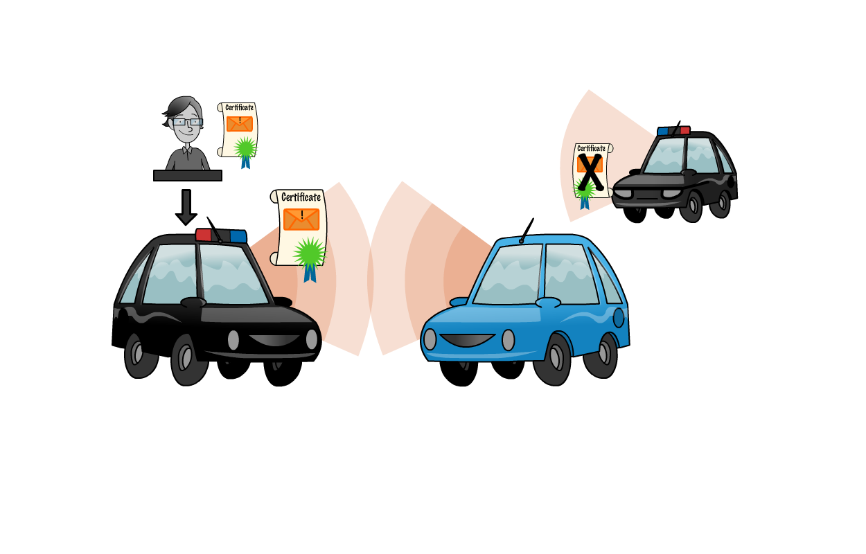
Authorization in practice (1)
Each application on a device has a credential that it cryptographically binds to a message
Credentials state
your permissions
If you don’t have a police car certificate, you can’t claim to be a police car

Slide 5
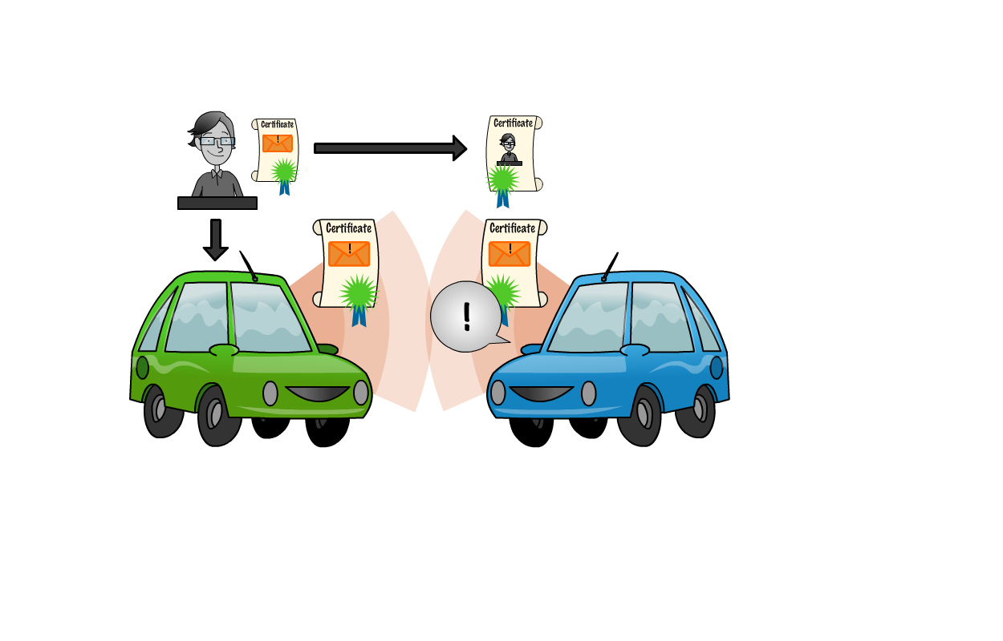
Authorization in practice (2)
How does the receiver trust received credentials?
The CA has a certificate itself which it binds cryptographically to the device’s certificate
The receiver knows the CA certificate
  Checks that the CA certificate authorizes and is bound to the device’s certificate
  Checks that the device’s certificate authorizes and is bound to the message
  Trusts the message!

Slide 6
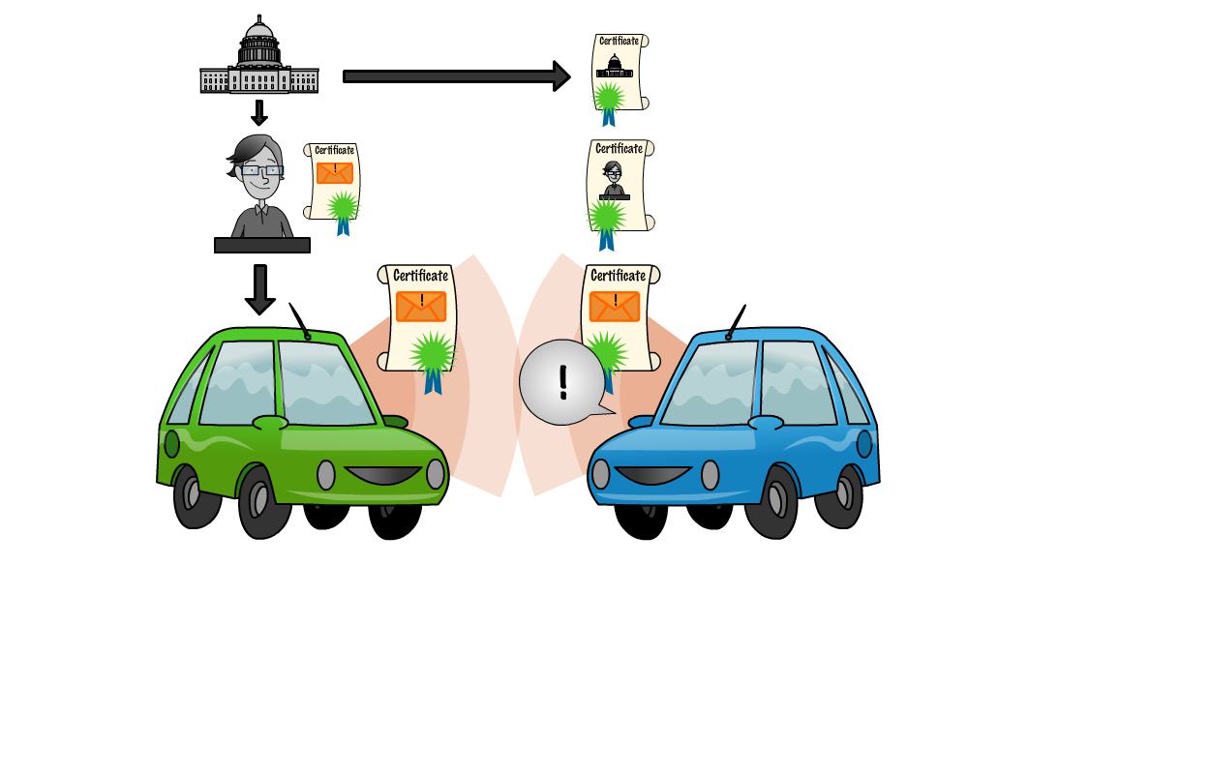
Authorization in practice (3)
How does the receiver know the CA certificate?
CA certificate might be known already
If it’s new, the receiver can construct a trust chain back to a root CA.
There’s a relatively small
set of root CAs, which are assumed to be known to everyone
  These can authorize an arbitrarily large number of intermediate and end-entity CAs

Slide 7

How do I get approved for a certificate?
Certificates are issued to approve particular activities
  In 1609.2, activities are identified by PSIDs
  In X.509, used for SSL, the certificate identifies the website that the owner can claim to operate
The Certificate Policy sets the requirements that a requester must meet to get a certificate
  CA enforces requirements
  Governance body / stakeholders write requirements
Certificate issuance conditions:
Correct software implementation
Ownership of claimed resources (website)
Sufficient hardware protection of signing keys
Sufficient software protection to prevent malware from using signing keys
…

Slide 8
Bad actors
A device that sends false messages should no longer
be trusted
Misbehavior Detection functionality detects
false messages
An enforcement function removes the bad
device’s privileges
  Either its credentials are “revoked” via a Certificate Revocation List (CRL)
  Or it uses its existing credentials till they expire but then does not get any more

Slide 9
Conclusions
Certificates allow holders to prove they have rights to
  Access (r/w/x) a particular resource
  Request a particular activity
  Send particular information
Can be issued in advance and used off-line
  Either some time in advance if revocation is used to remove bad actors
  Or shortly in advance if expiry is used
Well-understood solution to distributed identity management

