Slide 2
Right to Repair Update
ETI Tool Tech 2017
April 25, 2017

Slide 3
Key Legislative Initiatives for 2016 and Beyond
Right to Repair
Light Duty
Heavy Duty
Telematics
Embedded Software

Slide 4
Massachusetts Right to Repair: Current Requirements
Enacted in 2013
Requires car companies to provide same information, tools and software for model year 2002 and later vehicles that they provide dealers
OE’s must make information available to scan tool and third party service information providers with whom they have appropriate contracts, licensing and confidentiality agreements
Telematics access required if information is not available through OBD port
Aftermarket signed MOU in 2014 with car companies where they agreed to Massachusetts requirements nationwide

Slide 5
MY 2018 and Later Requirements
Information and tools to reside in cloud
Accessible with off-the-shelf PC
Connect with vehicle using standardized interface that meets TMC RP1210A, SAE J2534 or ISO 22900
Will the manufacturers be ready?

Slide 6
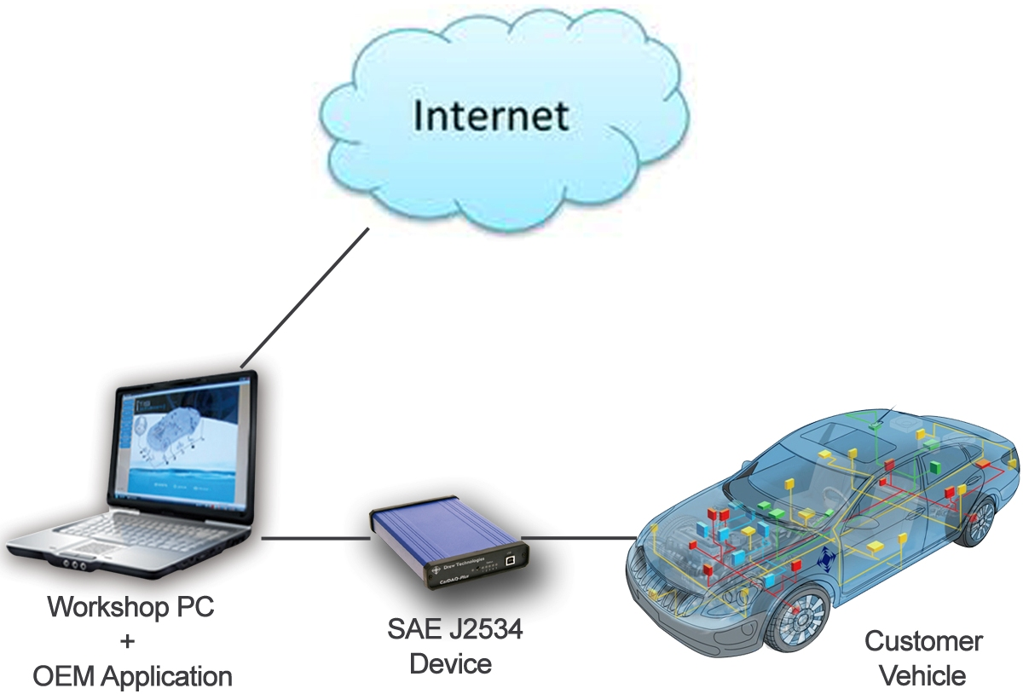
Model Year 2018 Cloud Based System

Slide 9
Tesla
Must comply with Massachusetts law
Not a party to MOU since they are not a member of either the Alliance or Global
Auto Care and CARE have sent a letter to Tesla requesting that they sign on to MOU
No response has been forthcoming

Slide 10
Enforcement-Light Duty
Independent must notify manufacturer in writing (Massachusetts requires notice to NASTF)
Manufacturer has 30 days to respond
If independent not satisfied with response, can appeal to dispute resolution panel comprised of Auto Care, CARE, Alliance, and Global Automakers
DRP has 10 days following meeting to make decision

Slide 11
Right to Repair Assessment Thus Far
In general, most light duty manufacturers are complying
Issues include difficulty in navigating websites to locate information
Programming capabilities continue to be headaches
Need for more education of technicians of what is available on sites and how to find it

Slide 12
Unresolved Issue: As Built Data
Many OE’s are not providing their VIN specific as-built data on websites
Dealers do have access to this information
Under terms of Massachusetts law and MOU, manufacturer need to provide access to same information they provide dealers
Will be following up with NASTF and possibly state on issue

Slide 13
OE Compliance with MY 2018 Requirements
Auto Care and CARE sent letters in late January to all OE’s that had signed the MOU requesting MY 2018 requirements
Of those, only the following responded that they were going to compliant: BMW, Ford, General Motors, Maserati, Mazda Mitsubishi, Subaru and Toyota
Hearing scheduled for early June in Massachusetts on compliance with law

Slide 14
Heavy Duty Right to Repair MOU
Signed with Engine Manufacturers Association in 2015
Applies to vehicles over 14,000 pounds
Requires access to diagnostic and repair information for 2010 and later commercial vehicles
Must be available to owners and independent repair facilities on a monthly and yearly subscription basis
Tools available that incorporate same diagnostic, repair and wireless capabilities that manufacturer makes available to dealer

Slide 15
Heavy Duty Right to Repair MOU
Data stream information to aftermarket scan tool companies with whom they have appropriate licensing, contractual or confidentiality agreements
Locations of sensors and computer modules
As-built parts information such that correct replacement parts can be used for repair

Slide 16
HD OEMs Support for MOU
Notes:
Published every Tuesday and Thursday and sent to all members who opt-in. Currently more than 5,200 subscribers.
AAIA-exclusive content includes the weekly AAIA/BB&T Weekly Automotive Aftermarket Intelligence Update, their quarterly M&A Report, the monthly Aftermarket Perspectives from The NPD Group and the monthly Telematics Trendline from Derek Kaufman.

Slide 17
HD Component Manufacturers Support for MOU
Notes:
Published every Tuesday and Thursday and sent to all members who opt-in. Currently more than 5,200 subscribers.
AAIA-exclusive content includes the weekly AAIA/BB&T Weekly Automotive Aftermarket Intelligence Update, their quarterly M&A Report, the monthly Aftermarket Perspectives from The NPD Group and the monthly Telematics Trendline from Derek Kaufman.

Slide 18
Exclusions
Certain immobilizer systems and reprogramming only available from manufacturers through a separate secure system
Telematics information
Trade secrets protected
Information not related to diagnostics or repair
Limited to information for systems included in the manufacturer’s as-built configuration

Slide 19
Enforcement-Heavy Duty
Independent must notify manufacturer in writing
Manufacturer has 30 days to respond
If independent not satisfied with response, can appeal to dispute resolution panel comprised of Auto Care, CVSN, ETI, HDAC and Engine Manufacturers
DRP has 10 days following meeting to make decision

Slide 20
Enforcement-Heavy Duty
Many heavy duty manufacturers appear not to be complying
According to CVSN, many sites still inadequate and fail to meet terms of MOU
Heavy Duty MOU in serious danger

Slide 21
Right to Repair Summary
MOU appears to be working in light duty
Working to ensure compliance with MY 2018 requirements. Will car companies be ready?
Major issue for aftermarket is absence of as-built VIN specific data
Heavy duty MOU may be in jeopardy

Slide 22
Telematics: The Future of the Auto Care Industry?

Slide 23
Connected Car Penetration: Big Picture
Parc=Cars in-use; Includes all light vehicles
Source: IHS Markit

Slide 24
How Telematics Affects Our Members
Manufacturers
Brand agnostic part fault and early wear out information
Earlier and more precise geolocation demand statistics
Retailers/Distributors
Refine assortment planning operations
Optimize geographic stock locations
Service Providers
Predictive maintenance, remote diagnosis and prognostics
Integrate ad hoc service with hot truck delivery
Notes:
If we have access to data…

Slide 25
Why Telematics Is A Big Deal
Currently only vehicle manufacturers can obtain data transmitted by a vehicle
Most systems permit car companies to send messages directly to motorists regarding vehicle health or other available services
Ultimately OBD port will disappear or be severely limited, leaving as the only source of diagnostic and repair data for late model vehicles

Slide 26
Auto Care Telematics Initiatives

Slide 27
Technical Solutions: Considerations
Ensure cyber protections for critical vehicle systems to ensure car owner safety and privacy
Permit with car owner permission, direct access to vehicle’s telematics system for purposes of offering repair and other services to customers
Cost and time to implement must also be considered as part of technical solution development

Slide 28
Proposed Technical Solutions Now Under Consideration
Secure Vehicle Interface (SVI)
“Extended Vehicle”

Slide 29
Preferred SVI Design

Slide 30
SVI
Advantages:
Standardized firewall protects vehicle from either wireless or OBD port intrusions
Permits full access to information needed to repair vehicle
Would work with either wired or wireless connections
Could be used with intelligent transport systems
Cyber secure – limits the point of attack to one entry point (the vehicle), not the servers of a car manufacturer for their entire connected fleet
Disadvantages:
Could take years to actually be implemented by OE’s
Even if adopted, industry would still need to push for access to telematics data

Slide 31
EVI
Advantages:
Could be implemented in near term
Would require no change to vehicle hardware or software
Disadvantages:
Data funneled through car companies’ infrastructure
Would not permit auto care industry direct access to vehicle
Proprietary access to the data

Slide 32
Impact on Auto Care Industry
Under extended vehicle concept, car companies would control what diagnostic information is transmitted, how it is transmitted and how much it would cost
Elimination of OBD port in future means that the extended vehicle concept would provide full control of access to data to automakers
Would make the manufacturer the sole source of information, tools and software needed to perform repairs

Slide 33
Auto Care’s Position
Strongly support creation and deployment of SVI
Aftermarket cannot support any concept that will eliminate direct access to vehicle telematics systems
EVI should not be endorsed by Association as either short or long term solution

Slide 34
Next Steps
Car companies and auto care industry met last November to discuss SVI
Agreement to have SAE look into the possibility of SVI
Extended vehicle option can be offered by vehicle manufacturers, but it is absolutely critical that there is direct access to a embedded telematics systems by independents with permission from car owner

Slide 35
Education – What Consumers Told Us
81%
Half
62%
of consumers think vehicle owners should decide who has access to telematics data
of consumers assume car owners have access to the data their car produces
of consumers haven’t heard of telematics
7out of 10
Consumers are willing to take action…
Over seven in 10 car owners think their vehicle data being transmitted to the auto manufacturer is a problem and demand a change.
Sign a petition (87%)
Write a letter to your congressman (65%)
Contact local elected official (62%)

Slide 36
Education Consumers Support Controlling Access to Their Data
Favor Owners’ Ability to Control Who Can Access?
Highest Favorability Intensity (Strongly Favor)
Somewhat
Seniors: 61%
Strongly
Baby Boomers: 58%
Town/Small City: 59%
C31. Given that the information transmitted from a vehicle is only transmitted to vehicle manufacturers, to what extent would you
favor or oppose vehicle owners having the ability to control who has access to their data? (n=1000)

Slide 37
Education
Auto Care believes that there is a need for strong education of consumers and industry regarding the need for car owners to control data transmitted by their vehicles
Development of program is currently in progress

Slide 38
Access to Embedded Telematics: Auto Care Plan of Attack
Educate industry, government and consumers on data ownership
Work with manufacturers and government on issues related to protecting vehicles from cyber security threats and access to embedded telematics systems

Slide 39
Embedded Software: The Next Right to Repair Battle?
Software is taking the place of mechanical control on many vehicle components
GM 2000 Tahoe had 9 computer control modules, now 2015 Tahoe has 70 modules
Through use of emerging technology, OEMs are limiting access to computer modules necessary to develop and fix electronics parts

Slide 40
Who Owns the Software
Right to repair doctrine in patent law always provided consumers with choices
Car companies using copyright law to restrict access to software for parts development and for repairs
Aftermarket companies being sued under copyright law taking OEM software off customer’s vehicles and installing on new part

Slide 41
Auto Care Position on Embedded Software
Affirm that Copyright law applies where and only to the extent that the technological measure actually protects a right of a copyright holder in a copyrightable work
Affirm that copyright law does not apply where the measure protects non-copyrightable aspects of software or markets for physical objects that the software controls
Make exemptions granted in a triennial presumptively permanent

Slide 42
Thank You!
Aaron Lowe
Senior Vice President, Regulatory & Government Affairs
aaron.lowe@autocare.org

