Slide 1
Current proposal for J1979-2 First Frame Escape Sequence
5-12-20

Slide 2
ISO 15765-2/ISO 15765-4 2016 version
SingleFrame
For unsegmented messages with CAN_DL ≤ 8, the message length is embedded in lower nibble
of the only PCI byte (Byte #1).
…
SingleFrame (SF)
shall be used to support the transmission of messages that can fit in a single CAN frame.
FirstFrame
A FirstFrame (FF) shall only be used to support the transmission of messages that cannot fit in a single
CAN frame, i.e. segmented messages. The FirstFrame of a segmented message is encoded as a
FirstFrame (FF). On receipt of a FirstFrame (FF), the receiving network layer entity shall start
assembling the segmented message. For segmented messages with a message length > 4095, the
FirstFrame escape sequence shall be used where the lower nibble of the first PCI byte (Byte #1) is set
to 0000₂ and the 2nd PCI byte (Byte #2) is set to zero. The message length is embedded in the
following four bytes (Byte #3 .. Byte #6, MSB first).
ISO 15765-4:
9 Transport protocol layer
The requirements of ISO 15765-2 are applicable for legislated OBD purposes with the exception that
CAN FD is not allowed. In addition, the FirstFrame escape sequence is only allowed when ISO 14229-1
UDS services are used for legislated OBD.

Slide 3
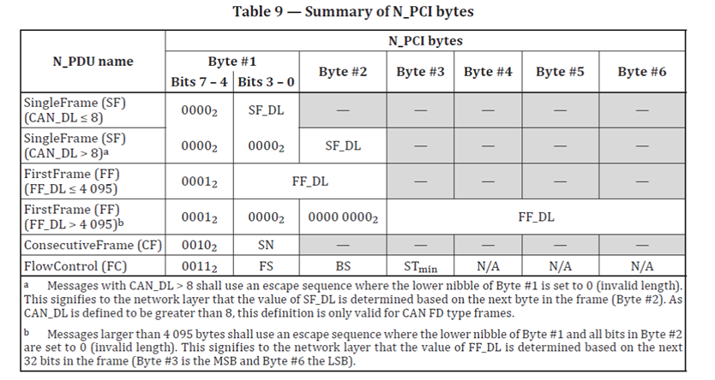
Table view of different Frame types – ISO 15765-2

Slide 4
FF escape sequence – requirement's and open points
If it is agreed for introduction of J1979-2 then all Clients and Server must support it.
It is only used when message > 4k on DoCAN.
If a Client does not support it (violating requirements) then it will see no response from the ECU
And should re-send the latest request. (with delay?).
It is difficult to detect which Clients do not support it.
If Server not support it, it will send an Negative Response Code 0x14.
Recommendation: Mandatory for Server and Clients.
Open points:
NRC $14 ís no longer required. Do we really need to keep it in SAE J1979-2? We don’t have a allowed use case, and sending of NRC 0x14 will against the standard.
FF esc sequences allows up to 4GB messages,
but 8/16/32KB will probable be the practical limit (supporting up to 2000/4000/8000 DTCs). Should be a requirement for minimum size in SAE J1979-2 and J1978-2? What happen if the size increase with Number of DTCs or new functionality?

Slide 5
ISO 15765-2/ISO 15765-4 #1 <4k
Client
Server
req
FF
#1 7-4 | #1 3-0 | #2 | #3 | #4 | #5 | #6
01 | FF-DL |  | - | - | - | -
FC
CF

Slide 6
ISO 15765-2/ISO 15765-4 FF #2 >4k NRC 14 - escape sequence is not supported from Server
Client
Server
req
SF
7F 14 req
#1 7-4 | #1 3-0 | #2 | #3 | #4 | #5 | #6
00 | SF-DL |  | - | - | - | -
FC
CF

Slide 7
ISO 15765-2/ISO 15765-4 #3 >4k FirstFrame escape sequence is supported from Server and Client
Client
Server
req
FF
#1 7-4 | #1 3-0 | #2 | #3 | #4 | #5 | #6
01 | 00 | 00 | FF_DL
FC
CF
4GB is possible but 8/16/32KB* is more probable.
*have to be defined from industry

Slide 8
ISO 15765-2/ISO 15765-4 FF escape sequence #4 >4k Client not supporting FF escape sequence
Client
Server
req
FF
#1 7-4 | #1 3-0 | #2 | #3 | #4 | #5 | #6
01 | 00 | 00 | FF_DL
Message is dropped.
Application will see no response

